Slide 1
Oral Manifestations of Noonan Syndrome
Eric S. Browning DMD, MS
Diplomate, American Board of Periodontology

Slide 2
Eric Browning DMD, MS
Diplomate, American Board of Periodontology
Private Practice for 19 years
Gum Surgery and Dental Implant Surgery
Medical Advisory Board for the Noonan Syndrome Foundation
Been Involved with NSF for about 8 years
Dental Lecture at each NS Conference
Residency and Master’s Degree from University of Texas

Slide 3
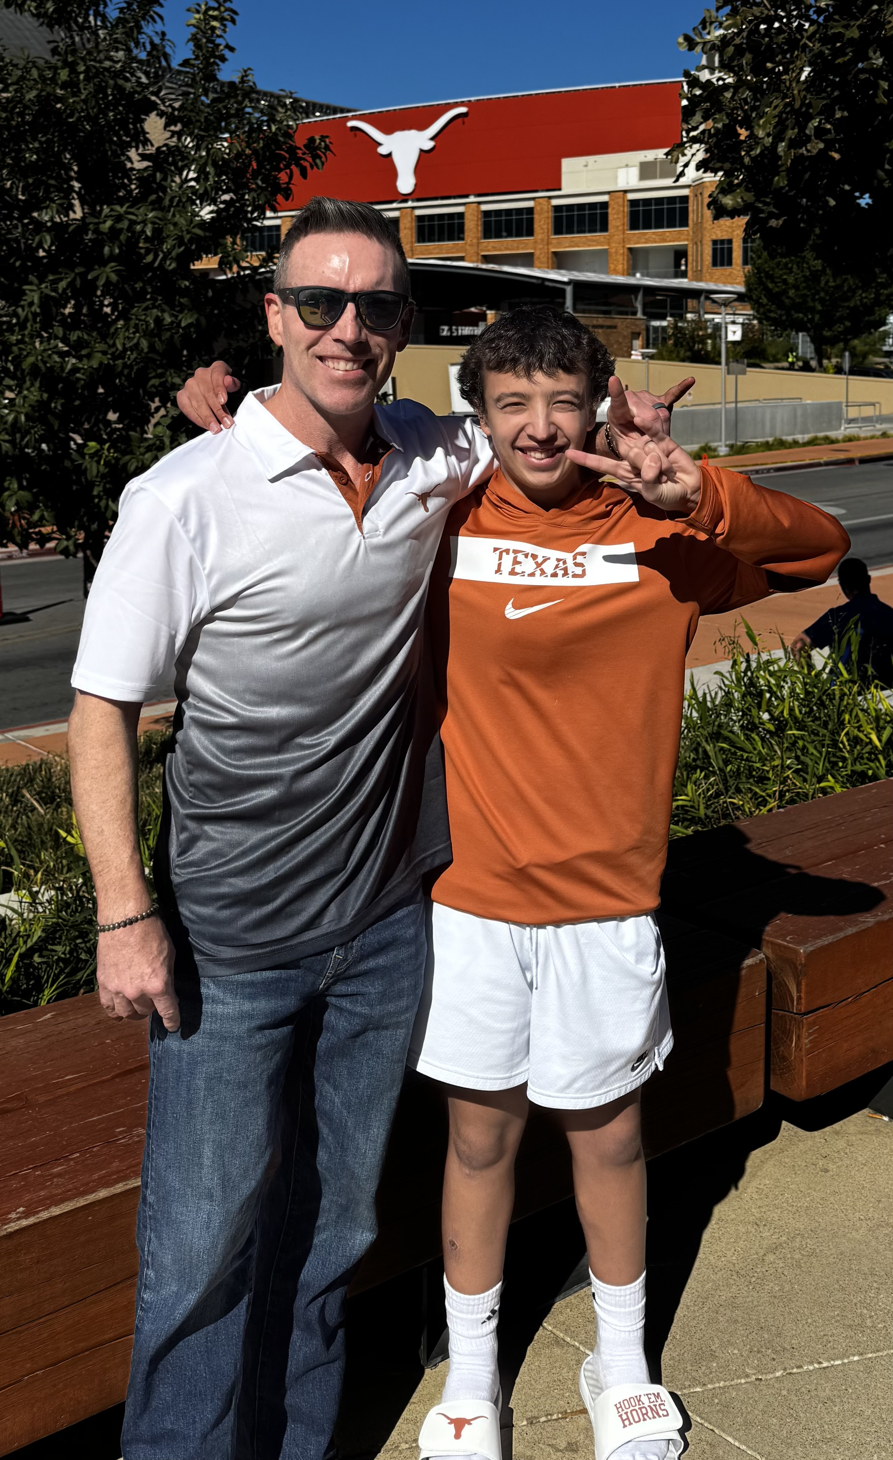

Slide 4
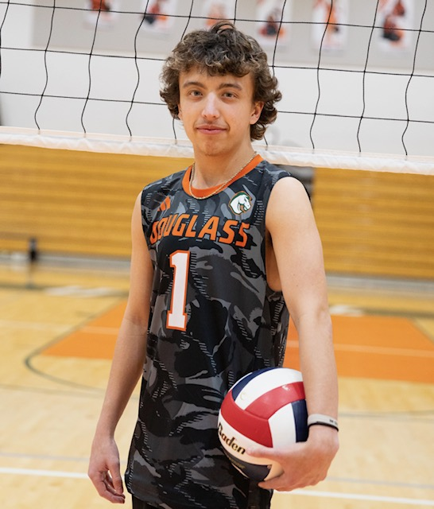

Slide 5
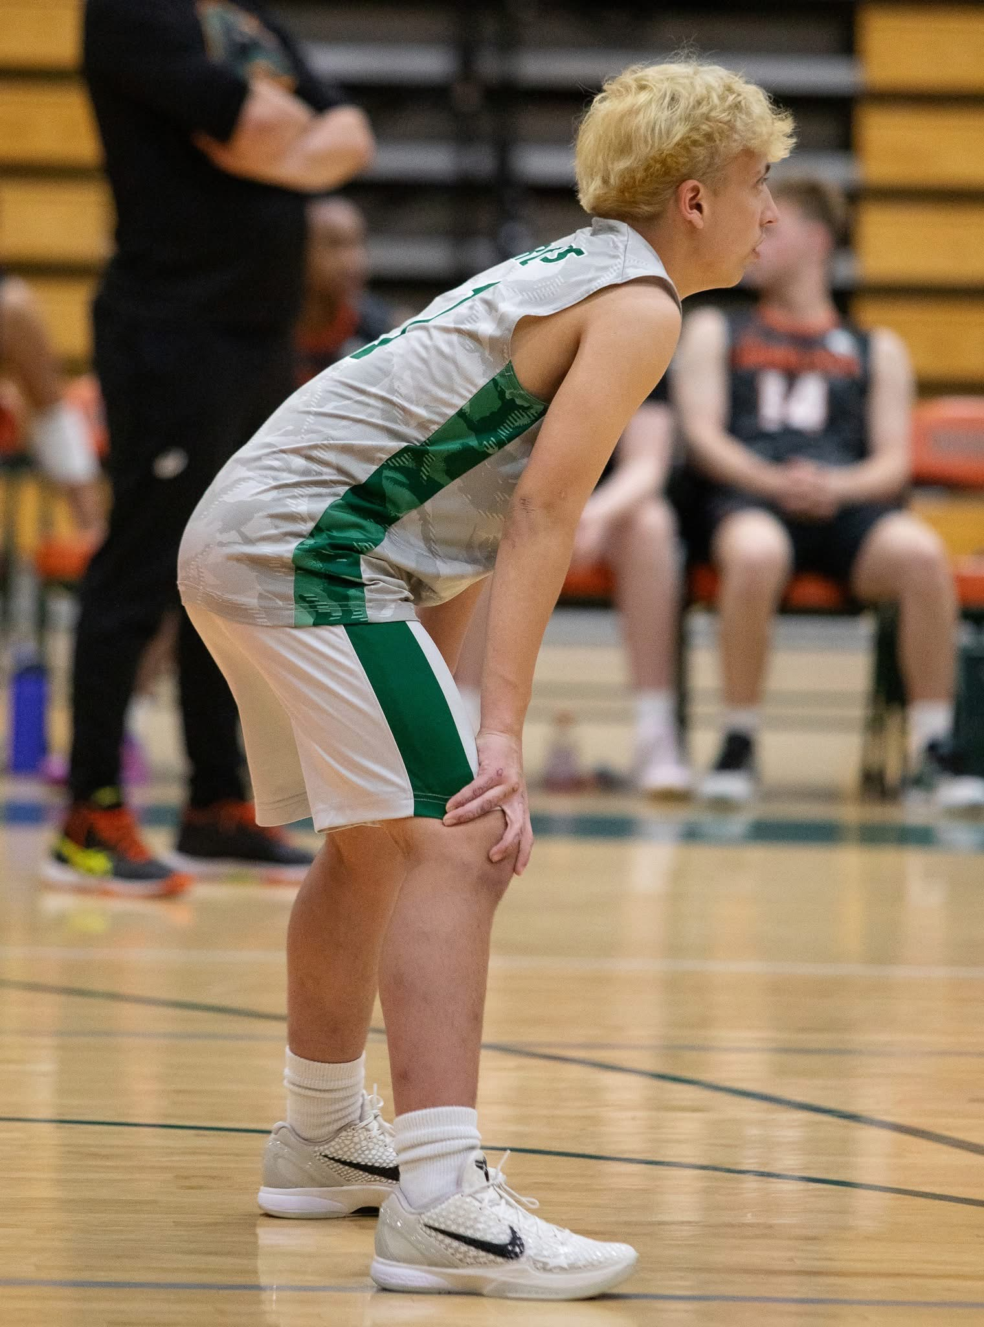
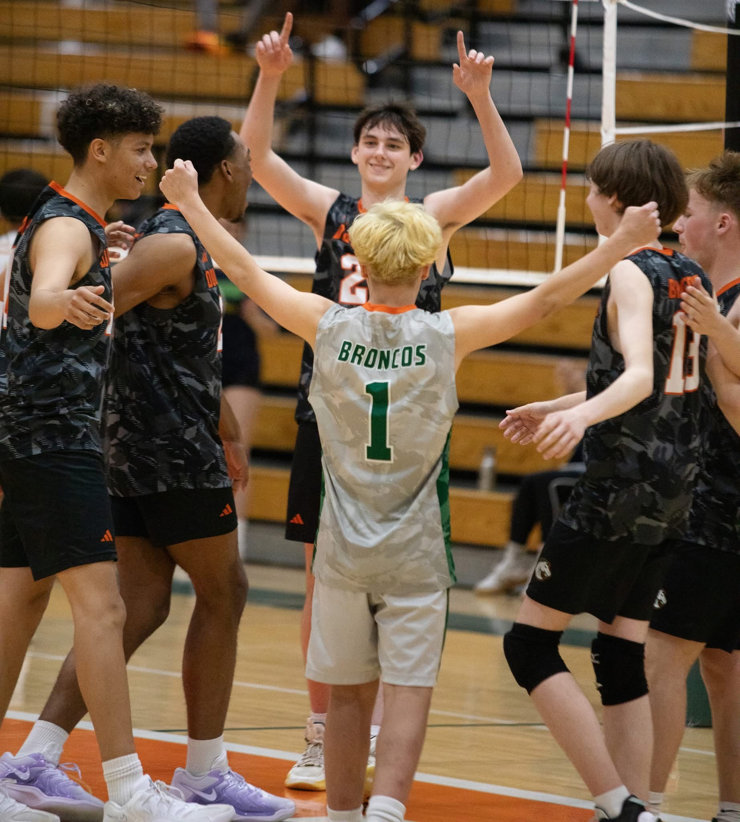
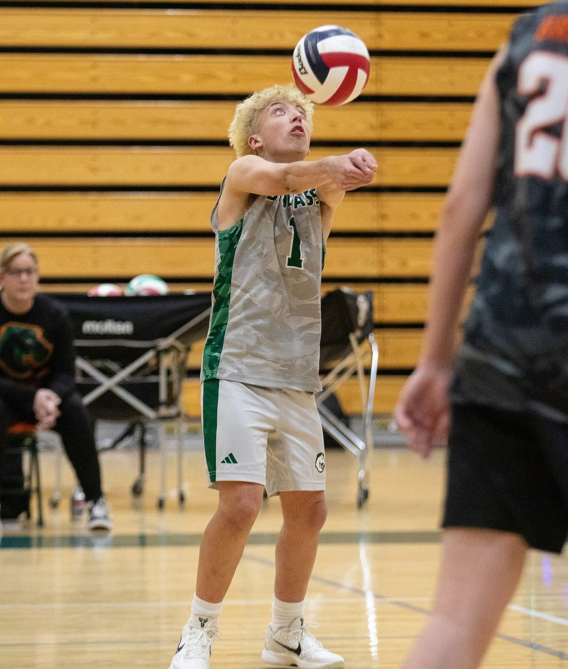

Slide 6
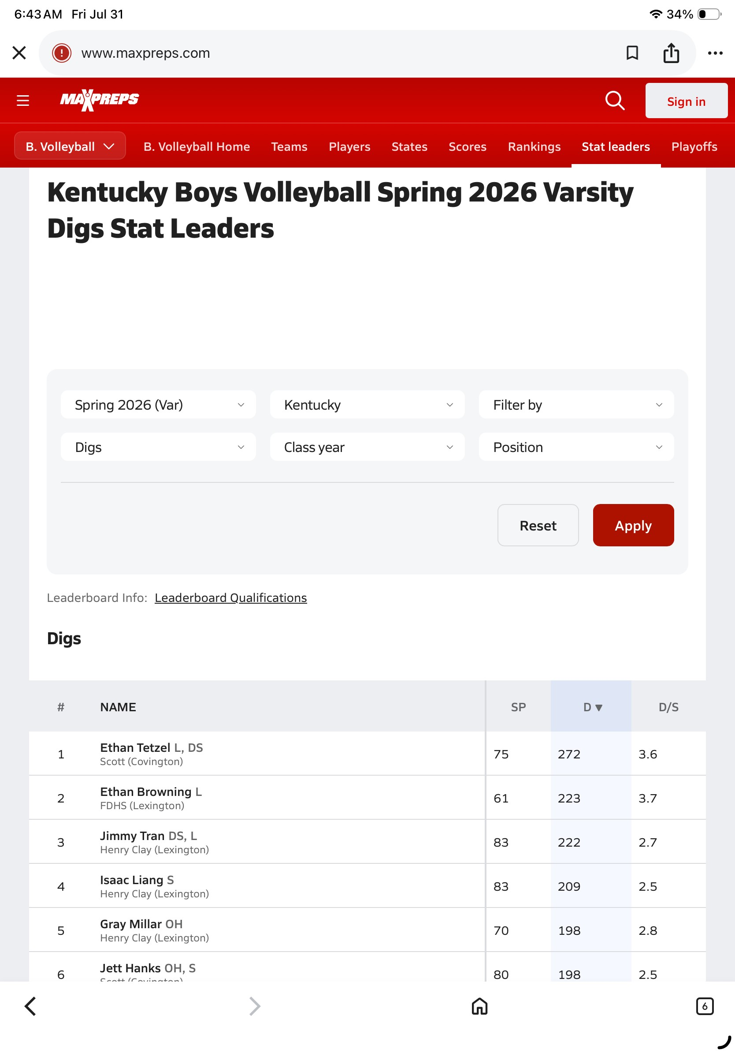

Slide 7
Contact Info
eric.browning77@gmail.com
859.321.8467

Slide 8
Dental Problems in Noonan Syndrome
Most issues are during childhood/adolescent years
Tend to normalize in adulthood

Slide 9
Oral Manifestations in Noonan Syndrome
Structural and Developmental Issues of the Jaws
Structural and Developmental Issues of the Teeth
One Jaw Tumor of Significance
Eruption and Shedding of Teeth
Malocclusions (teeth don’t fit together as they should)

Slide 10
What Will Not Be Covered?
Sensory Issue Solutions
Oral Aversion Solutions
Best Handled By An Occupational Therapist or Speech Pathologist
Lisa Otto, Occupational Therapist Speaking Later This Afternoon

Slide 11
Most Common Oral Findings in Noonan Syndrome
1) Crowded Teeth

Slide 12
Tooth Crowding in Upper Jaw Versus Lower Jaw
The cause of tooth crowding is different in the upper jaw versus lower jaw

Slide 13
Why do we tend to have crowded teeth in the upper jaw?
2) High (Narrow) Palate

Slide 14
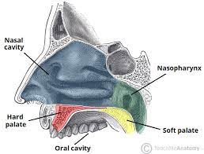
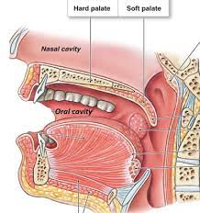
Hard Palate (Roof of Mouth)

Slide 15
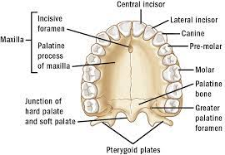
Hard Palate Anatomy

Slide 16

High Arched Palate
Tooth Crowding due to a V shaped arch instead of a U shaped arch

Slide 17
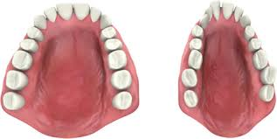

Slide 18
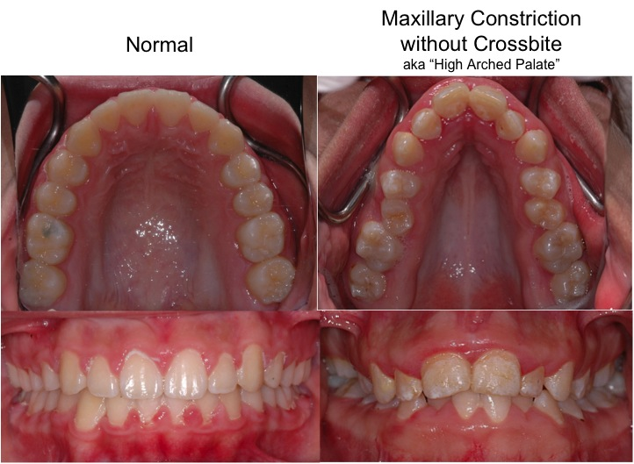

Slide 19
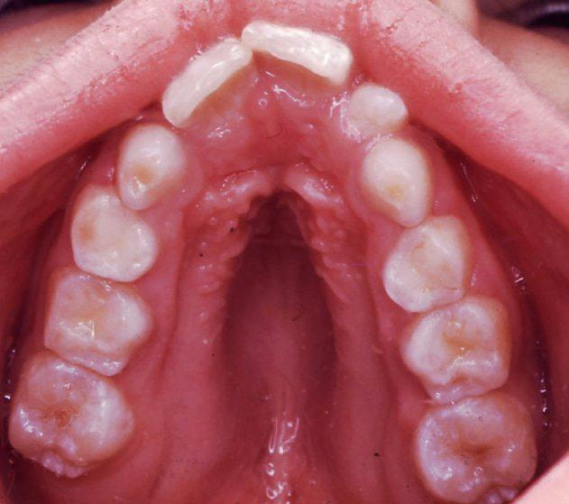

Slide 20
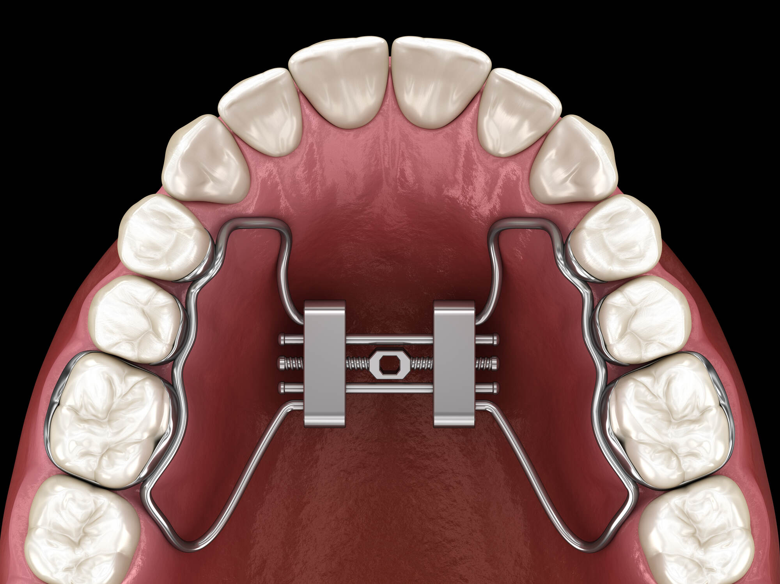
Palatal Expander

Slide 21
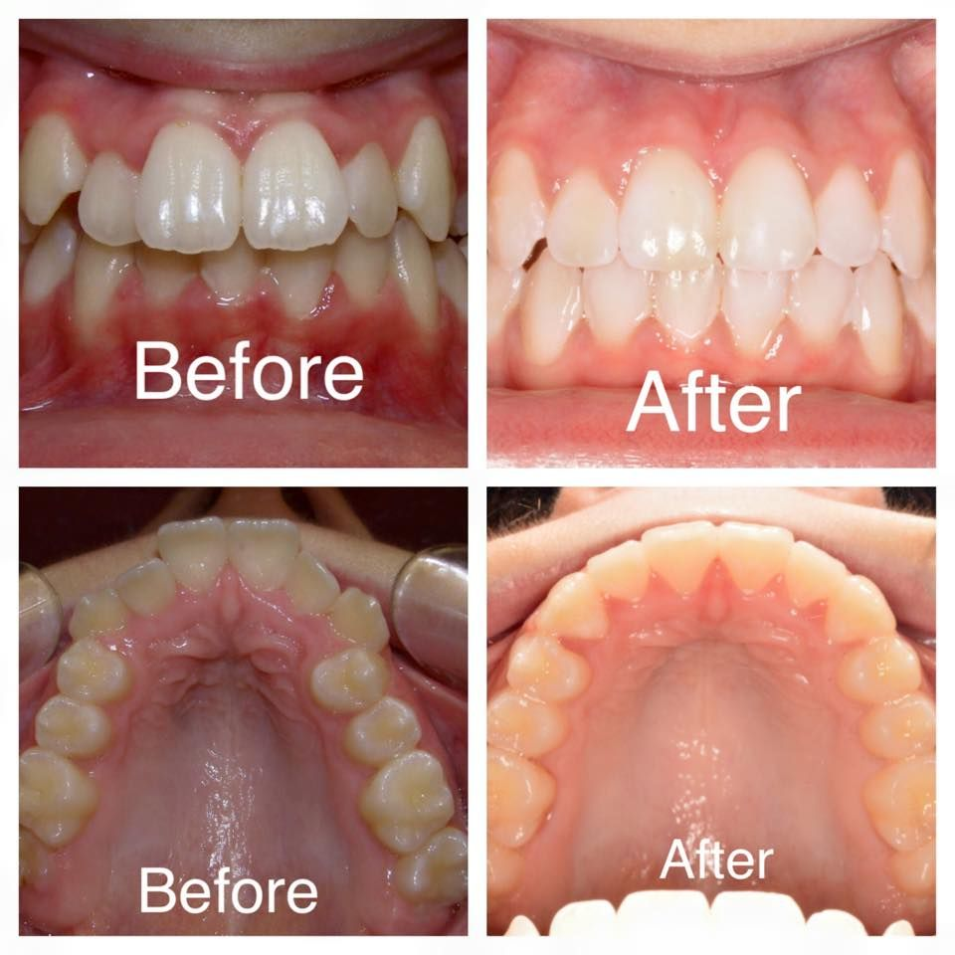

Slide 22
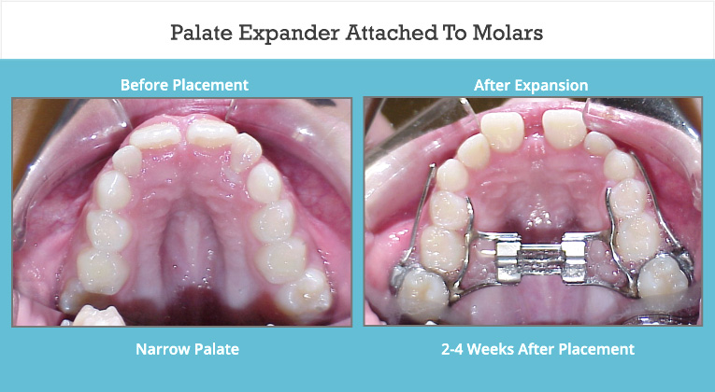

Slide 23
Hard Palate Anatomy

Slide 24
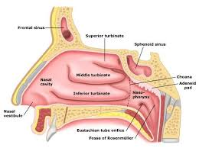

Slide 25
High Arched Palate
Palate is roof of mouth, but also floor of the nose
Decreases size of the nasal cavity
Makes nasal breathing difficult
Small nasal areas difficult to clear mucous can lead to congestion
Increase in sleep disordered breathing (one of the reasons)

Slide 26
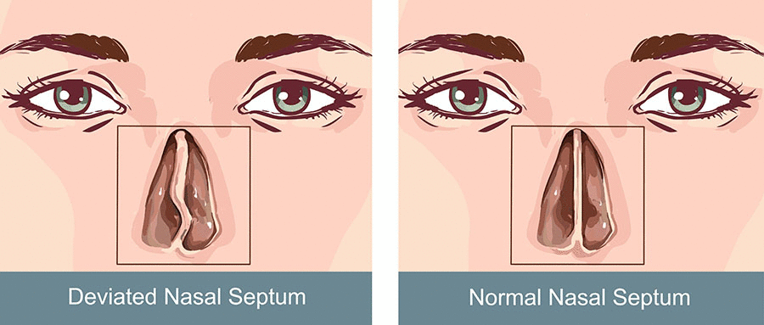
Deviated Septum

Slide 27
How Does Our Breathing Habit Change?

Slide 28
High Arched Palate
Mouth breathers
Humans did not evolve to breathe through the mouth
Changes facial features (long face, down slanting eyes)
Pressure from tongue on the roof of mouth contributes to midface development (try breathing through mouth with tongue on palate)

Slide 29
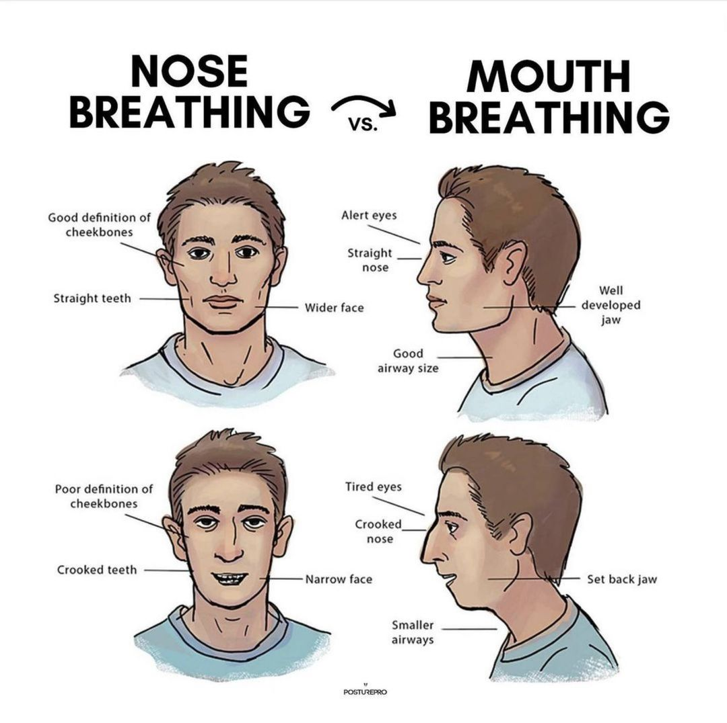

Slide 30
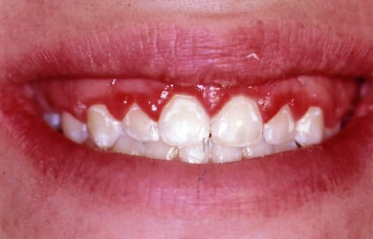
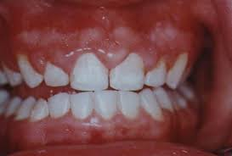
Gingival Inflammation from Mouth Breathing

Slide 31
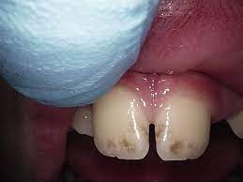
Enamel Demineralization from Mouth Breathing

Slide 32
Why Do We Have Crowded Teeth in the Lower Jaw?

Slide 33
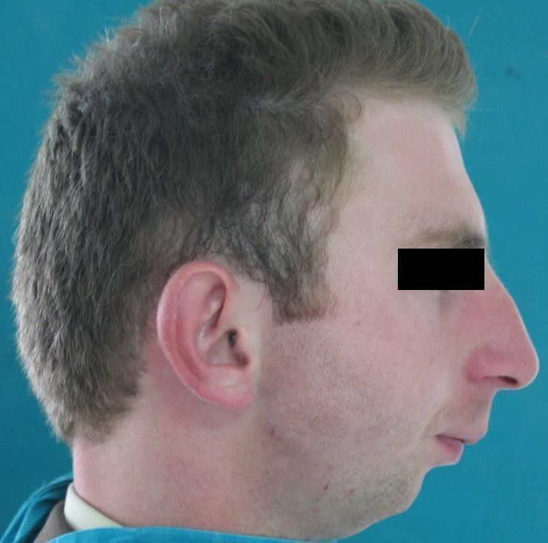
Micrognathism (undersized jaw)

Slide 34
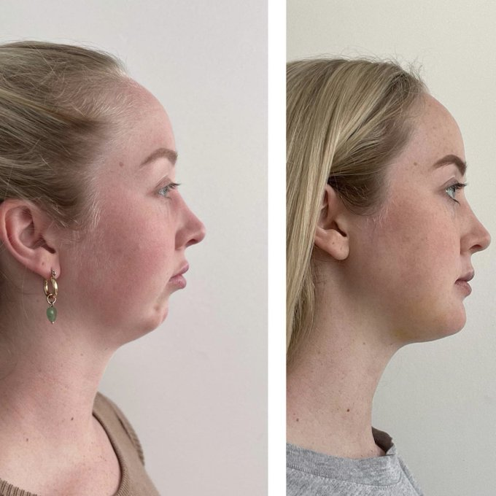

Slide 35
Micrognathia (small jaw) Symptoms in Children
Because jaw is undersized, it leads to tooth crowding
Infants tend to show signs of “failure to thrive”
Apneic spells (temporary stop in breathing during sleep)
Inability to feed
Prolonged feeding
Noisy breathing
Poor ability to sleep
Poor ability to gain weight

Slide 36
Micrognathia (small jaw)
Most of these problems occur because the tongue is blocking the airway

Slide 37
Good News

Slide 38
Micrognathia (small jaw)in Noonan Syndrome
Tends to correct itself to an extent as the child grows
Most are treated without the need for surgery

Slide 39
Malocclusions
Teeth do not align correctly
Consequence of high palate and small lower jaw

Slide 40
Overbite
Overlap of the front teeth over the bottom teeth
Normal
Excessive overbite can cause the front teeth to bite down on the lower gums

Slide 41
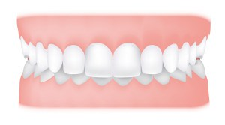
Excessive Overbite (Deep Bite)

Slide 42
Crossbite
Upper teeth bite inside of your lower teeth
Consequence of a high palate

Slide 43
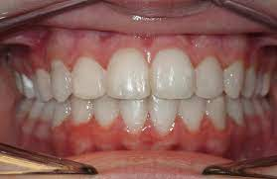
Normal Bite

Slide 44
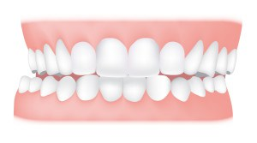
Crossbite

Slide 45
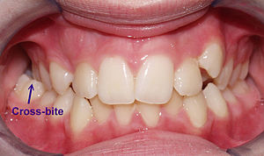

Slide 46
Treatment of Malocclusions (teeth don’t fit together as they should)
Orthodontics
Jaw surgery in a few select cases

Slide 47
Tooth Development Anomalies

Slide 48
Missing Tooth (Hypodontia)
Certain teeth do not develop
In Noonan Syndrome, seen with wisdom teeth, upper lateral incisors, lower premolars most commonly

Slide 49
Missing tooth (hypodontia) in Noonan Syndrome
Not necessarily a bad thing
Alleviates some of the crowding
Many times, involves less work for the orthodontist
Less time in braces for the patient

Slide 50
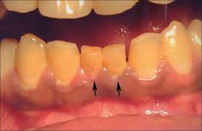
Retained Primary Teeth

Slide 51
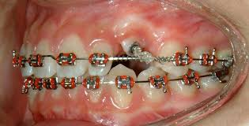
Unerupted Permanent Tooth

Slide 52
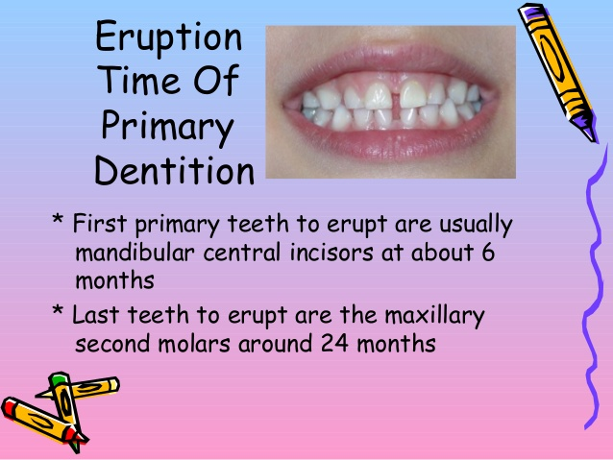
Eruption Times

Slide 53
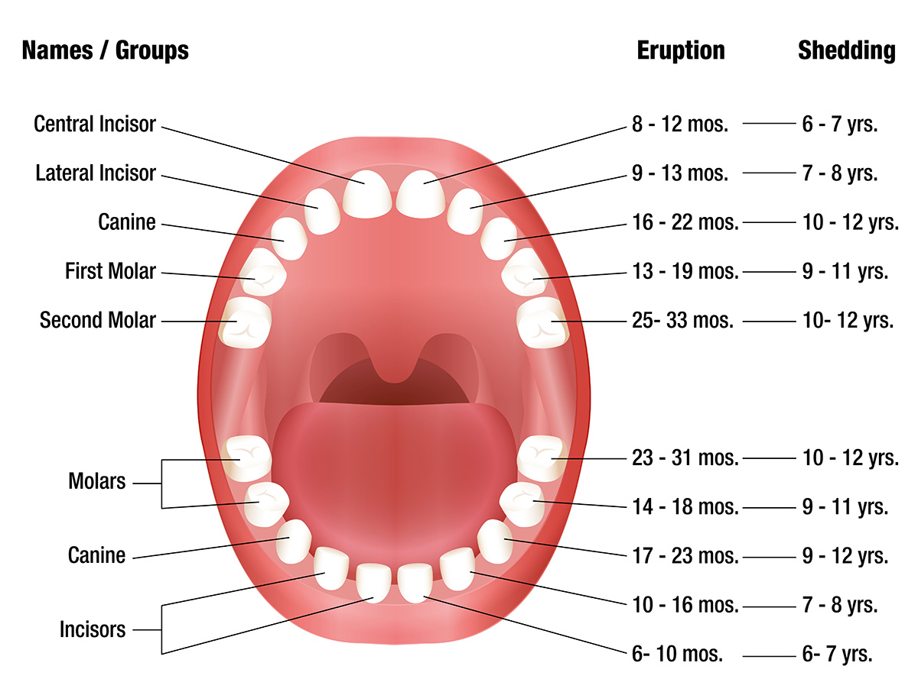
Delays In Getting Primary Teeth/Losing Primary Teeth

Slide 54
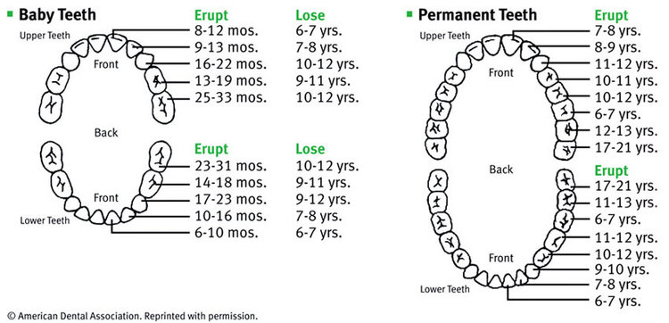
Delays in Permanent Teeth Eruption

Slide 55
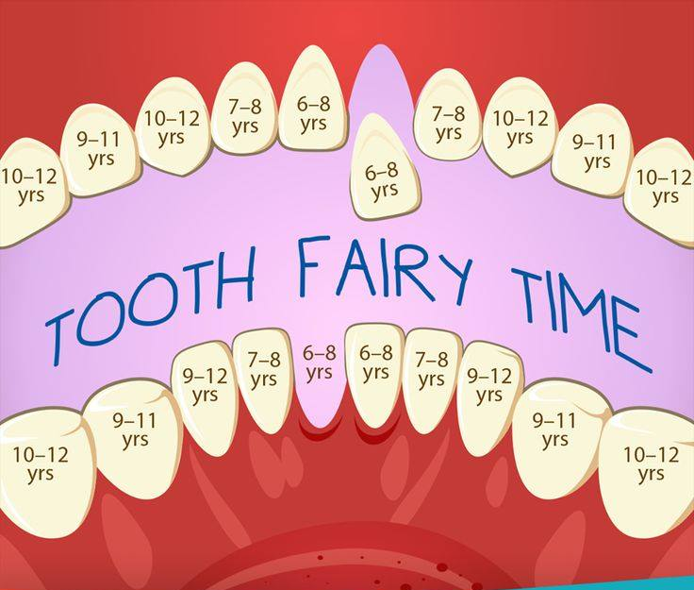
Tooth Fairy Time Is Delayed

Slide 56
One Jaw Tumor of Significance

Slide 57
Central Giant Cell Granuloma
Tumor of the jaw
Not cancer
It is potentially destructive

Slide 58
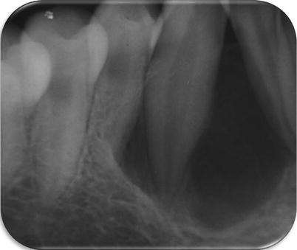
Central Giant Cell Granuloma

Slide 59
Central Giant Cell Granuloma
Most are discovered on routine radiographic examination or as painless expansion of the affected bone

Slide 60
Central Giant Cell Granuloma
Asymptomatic slow growing lesion to aggressive tumor causing pain and expansion of the jaw
Anterior mandible/premolar area is most common area of occurrence
Younger adults (30yo or under)
Females>Males (2x female predilection)
Aggressive type tends to recur
Can displace teeth

Slide 61
Central Giant Cell Granuloma
60% occur before age 30
70% arise in mandible

Slide 62
Central Giant Cell Granuloma
Treatment of choice is surgical removal

Slide 63

What If Surgery Is Not An Option?

Slide 64
Xgeva® (denosumab)
Subcutaneous injection treatment
Prevent serious bone problems in people with certain types of cancer such as multiple myeloma or people with cancer that has spread to the bones
Given every 4 weeks for treatment of central giant cell granuloma
Treatment length no shorter than 12 months

Slide 65
Conclusion
Oral health care for NS patients should commence early in life, in order to prevent problems from becoming irreversible
Proactive orthodontic treatment should be administered as early as possible to address the high arched palate/tooth crowding/bite issues
Regular dental visits are a must
Just because it does not hurt is no excuse to skip your visit to the dentist

Slide 66
THANK YOU
eric.browning77@gmail.com

