Slide 1


THE MILKY WAY:
Lymphatic Involvement in Noonan Syndrome
Bruce D. Gelb, M.D.
Mindich Child Health and Development Institute
Departments of Pediatrics &
Genetics and Genomic Sciences
July 2026

Slide 2
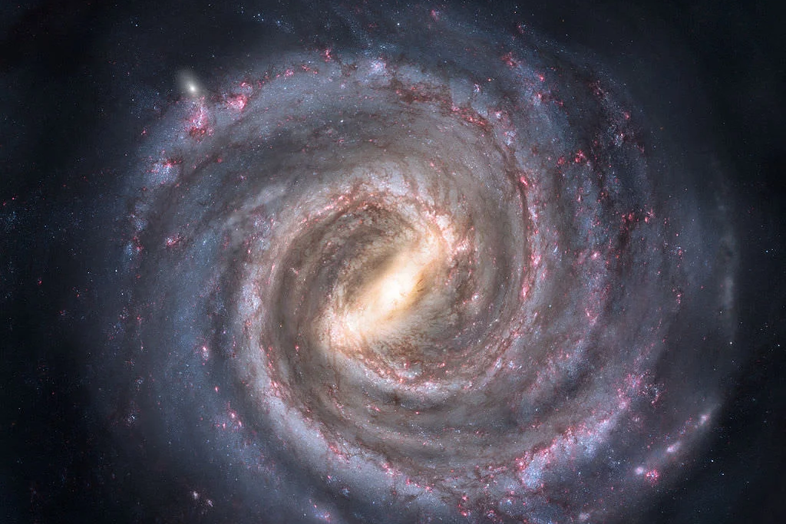

Slide 3


Slide 4


Slide 5
What is the lymphatic system?
Is that just for infections?

Slide 6

NS Lymphatic Involvement
LYMPHATIC 101
Known Fondly as the Body’s Sewer System!

Slide 7
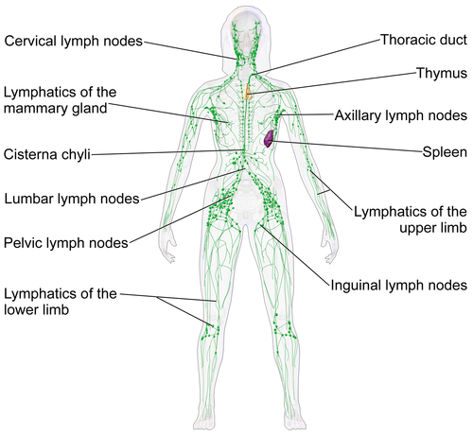
NS Lymphatic Involvement
LYMPHATIC 101

Slide 8
NS Lymphatic Involvement
FREQUENCY AND ASSOCIATIONS
Swarts et al., Dutch Patients, 2022
Lifetime Risk 37%
Prenatal 20%
Postnatal 30%

Slide 9
NS Lymphatic Involvement
FREQUENCY AND ASSOCIATIONS
Infancy
  Peripheral Lymphedema 19%
  Chylous Effusions 7%
Adulthood
  Peripheral Lymphedema 29%

Slide 10
NS Lymphatic Involvement
FREQUENCY AND ASSOCIATIONS
Risk Factors
  Fetal Lymphatic Increases Postnatal Risk 4.9 Fold
  Genotype: RIT1 and SOS2 Increase Risk
  PTPN11: Certain Parts of the Protein
  No Association with Congenital Heart Disease

Slide 11
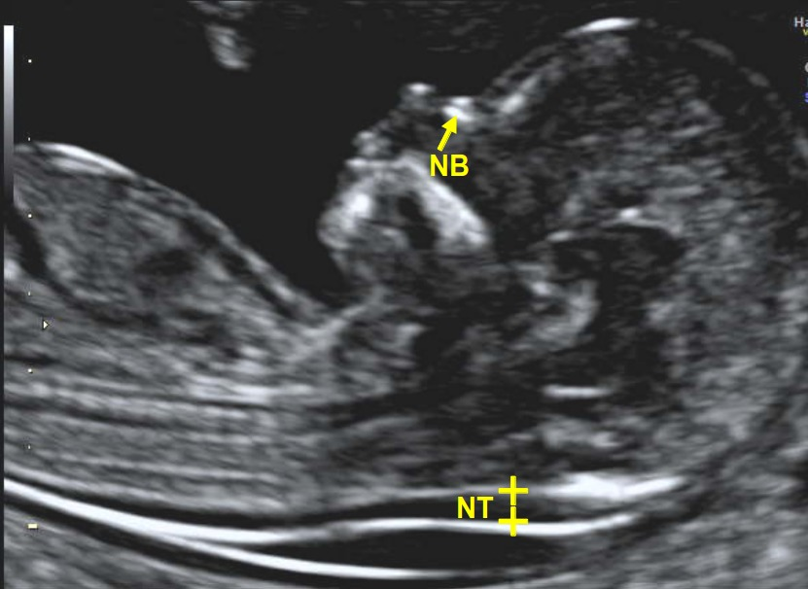
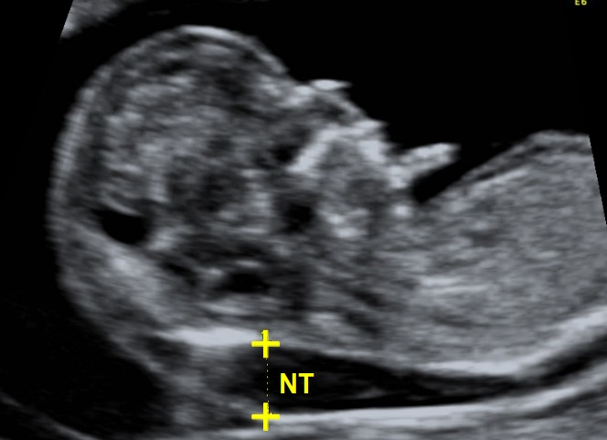
NS Lymphatic Involvement
Increased Nuchal Translucency

Slide 12
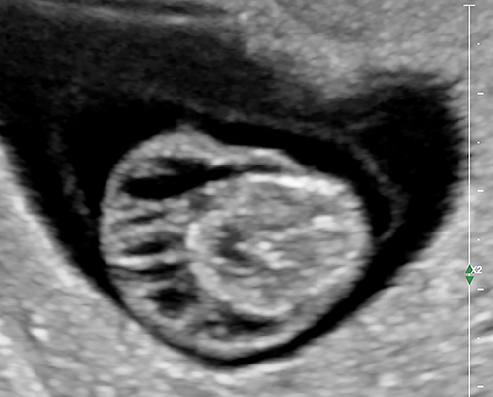
NS Lymphatic Involvement
Cystic Hygroma

Slide 13
NS Lymphatic Involvement
Pre-Natal Issues
20% Increased Nuchal Translucency
30% Cystic Hygroma
30% Pleural Effusions (Fluid around the Lungs)
20% Hydrops Fetalis (Fluid everywhere)
Frequencies Depend on Gene (RIT1 > PTPN11)

Slide 14
NS Lymphatic Involvement
POSTNATAL ISSUES
Peripheral Lymphedema (Swelling of the Legs)
  Onset in Infancy vs. Adolescence or Early Adulthood
Chylothorax (Chyle in the Chest)
Chylous Ascites (Chyle in the Abdomen)
Protein-Losing Enteropathy (Gut Leaks Proteins)
Pulmonary Lymphangiectasia

Slide 15
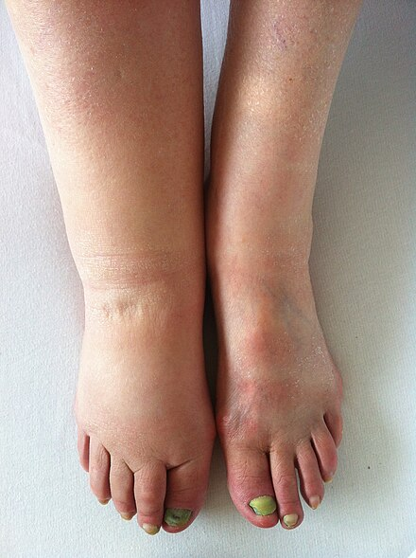
NS Lymphatic Involvement
Lymphedema

Slide 16
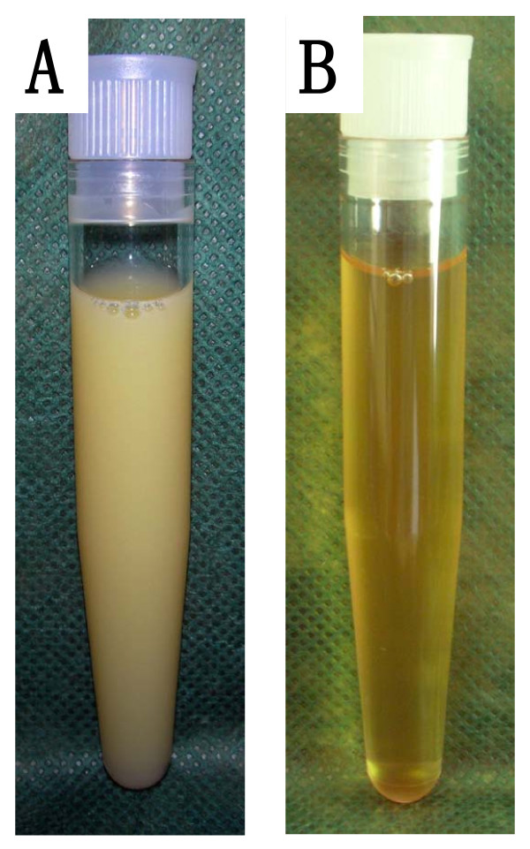

NS Lymphatic Involvement
LYMPHATIC 101
Lymph Fluid + Fat = Chyle

Slide 17
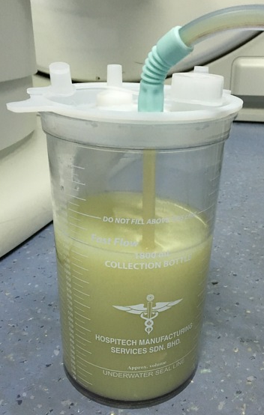

NS Lymphatic Involvement
CHYLOUS PLEURAL EFFUSION

Slide 18
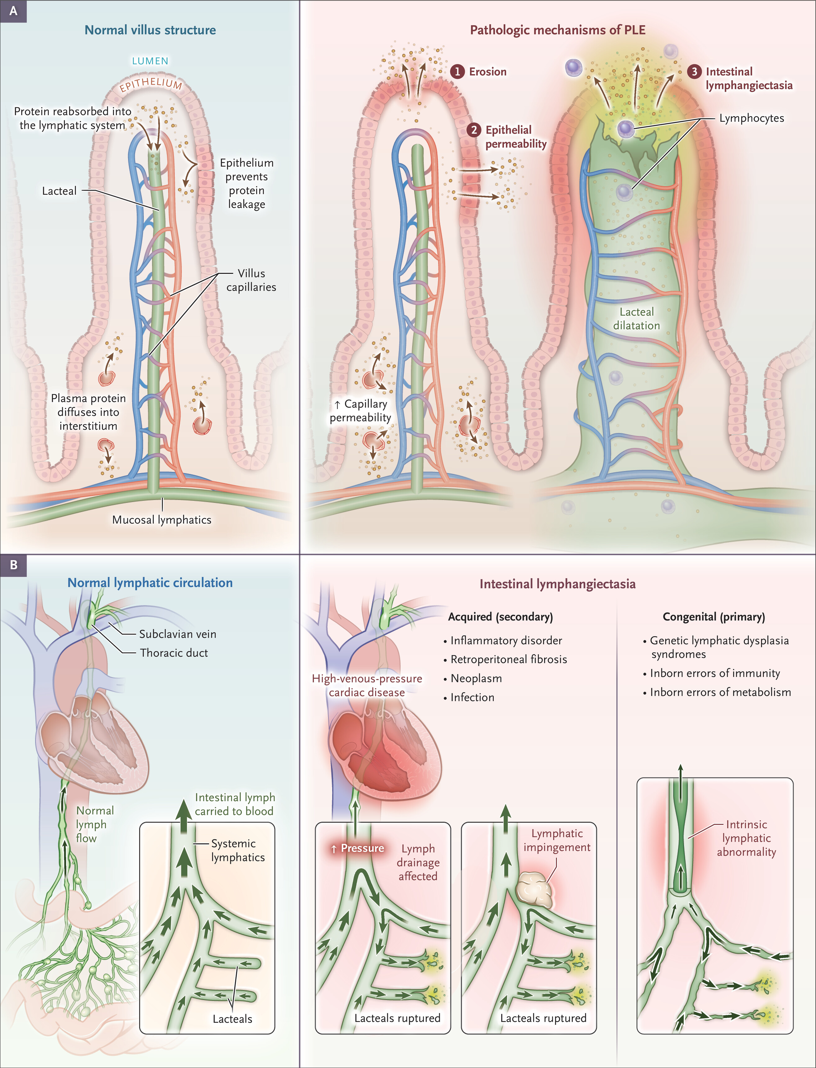
NS Lymphatic Involvement
PROTEIN-LOSING ENTEROPATHY

Slide 19
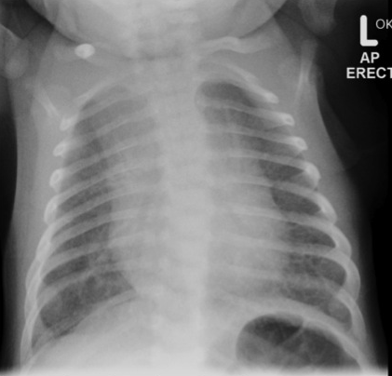
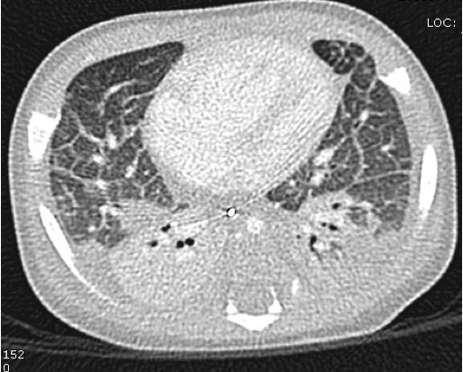
NS Lymphatic Involvement
PULMONARY LYMPHANGIECTASIA

Slide 20
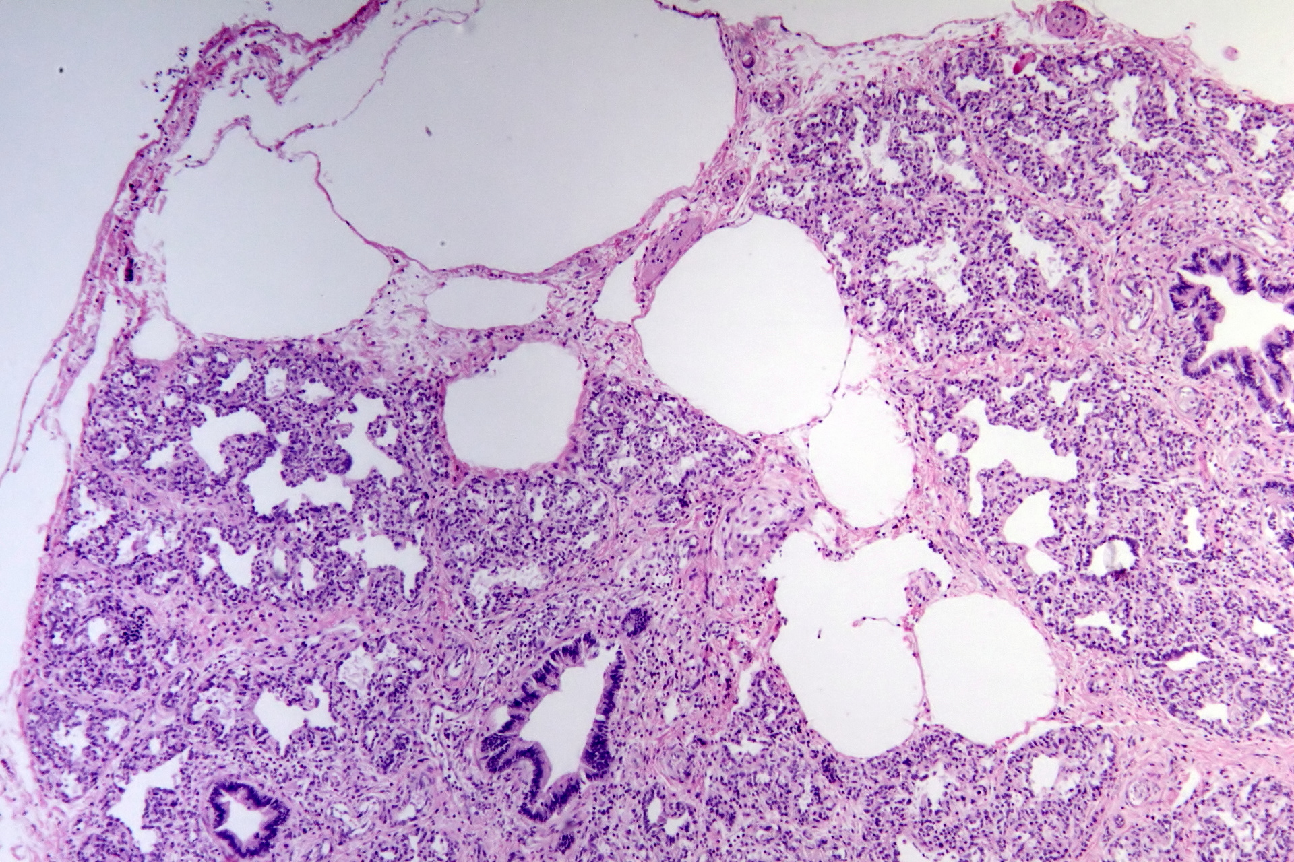
NS Lymphatic Involvement
PULMONARY LYMPHANGIECTASIA

Slide 21
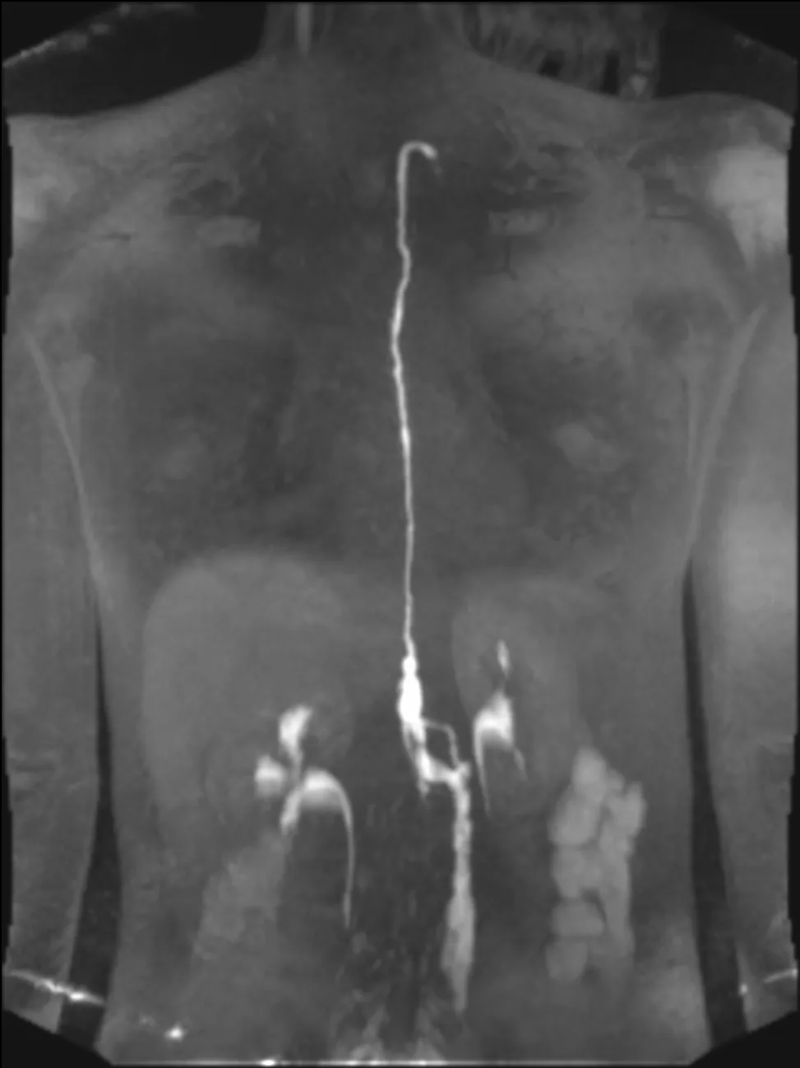
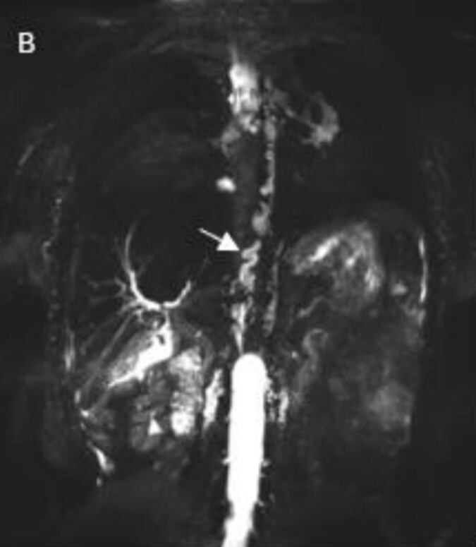
Lymphatic Imaging
MAGNETIC RESONANCE

Slide 22
NS Lymphatic Imaging
FREQUENCY OF ABNORMALITIES
Sheyanth et al., 2026
MR Imaging
  10 Controls
  10 Noonan Syndrome (5 with/5 without Lymphatic Issues)
Abnormal Thoracic Ducts
  Controls: 2/10 Abnormal
  Noonan Syndrome: 8/9 Abnormal

Slide 23
NS Lymphatic Involvement
CONVENTIONAL TREATMENTS
Peripheral Lymphedema
  Observe
  Compression Stockings
Chylous Effusions
  Low-Fat Diets
  Medications (Usefulness Unclear)
Health-Threatening Issues
  Catheterization-Based Interventions
  Surgery

Slide 24
NS Lymphatic Involvement
TREATMENT OUTCOMES
Literature Review
  18 Patients in 10 Papers
Surgical Incision or Ligation
  Terrible Results
Targeted Interventions
  Stable or Minor Benefit: 5
  Resolution: 1
  Bleeding or Death: 2
Surgical Lymphatic-Vein Connection
  4 of 4: Good Outcomes Short Term

Slide 25
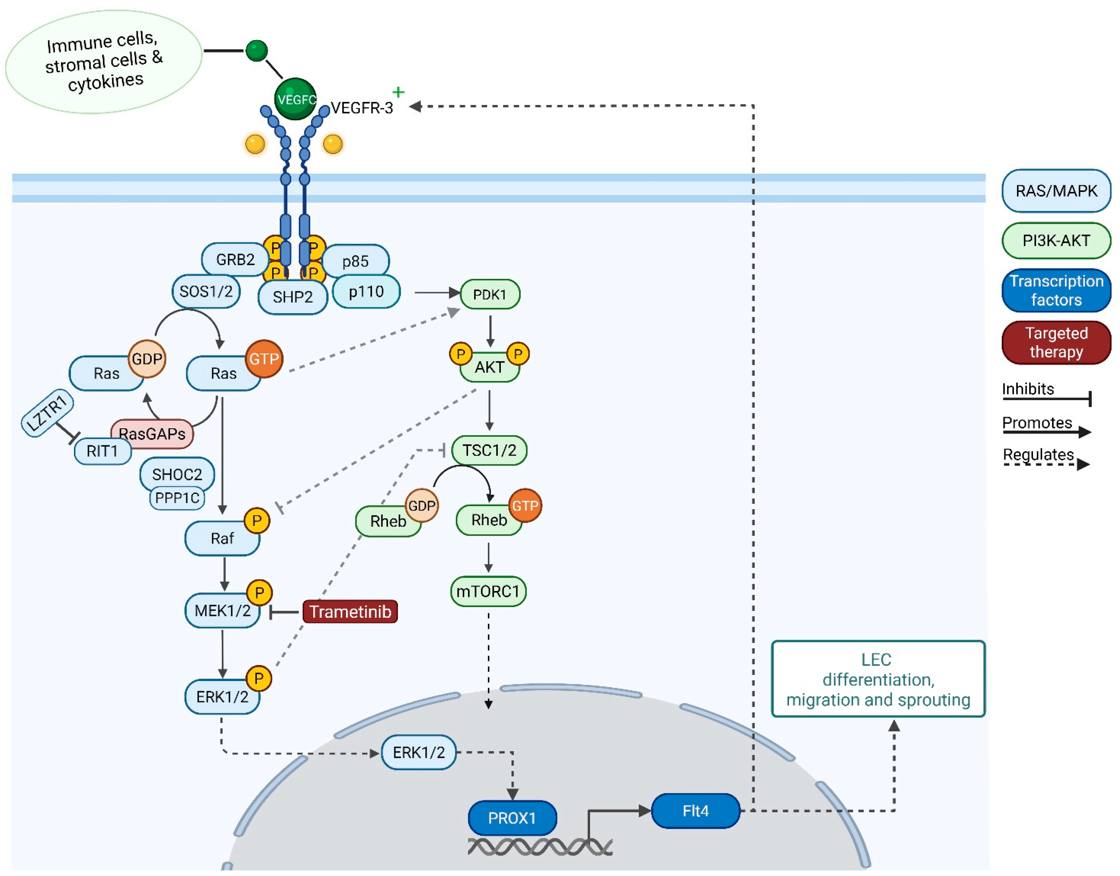
NS Lymphatic Involvement
BIOLOGY AND MECHANISTIC THERAPY

Slide 26
NS Lymphovascular Disease
TRAMETINIB TREATMENT
16-Year-Old with NS (SOS1)
  Chylothorax and PLE
  Mesentreric and Pulmonary Lymphangiectasia
  Failed Medical and Interventional Approaches
Trametinib 1 mg/day
  Symptoms Resolved by 8 Weeks
  Remained Well on Treatment at 6 Months

Slide 27
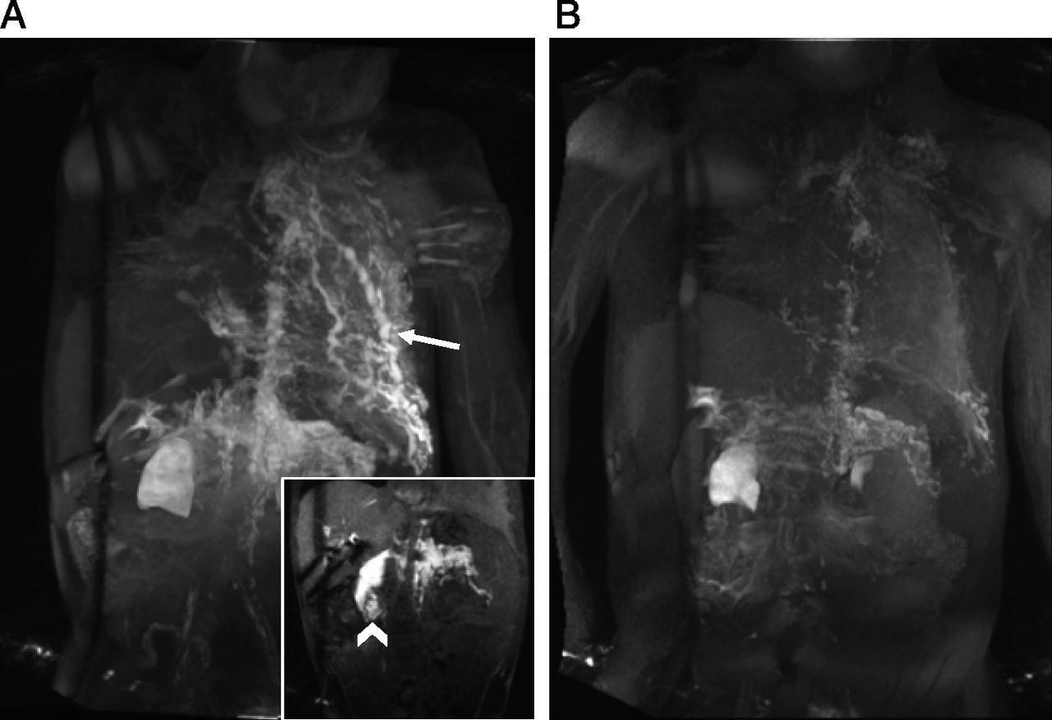
NS Lymphovascular Disease
TRAMETINIB TREATMENT
Before
After
Dori, Pediatrics 2020

Slide 28
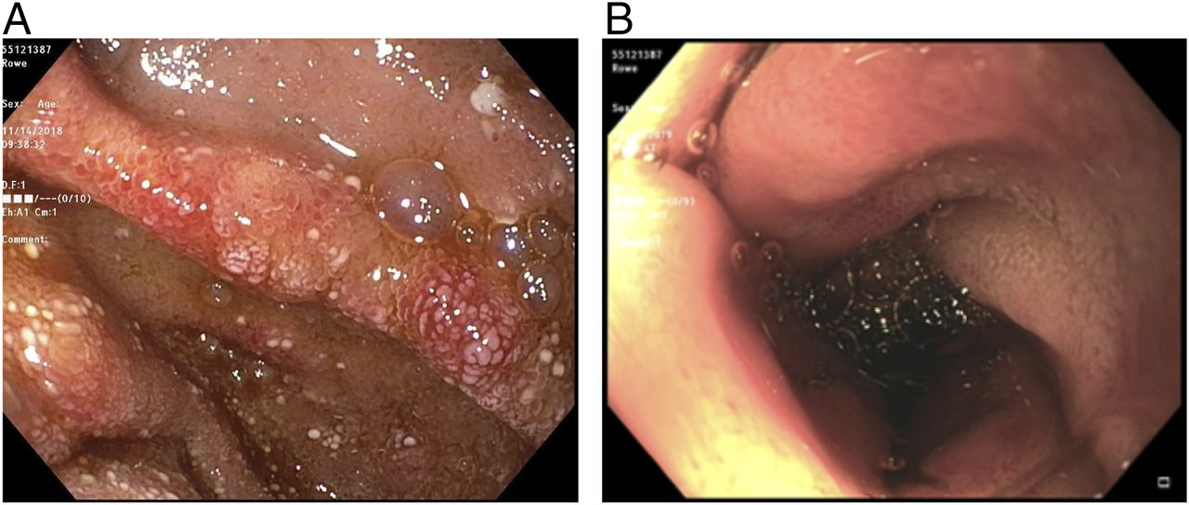
NS Lymphovascular Disease
TRAMETINIB TREATMENT
Before
After
Dori, Pediatrics 2020

Slide 29
NS Lymphovascular Disease
TRAMETINIB TREATMENT
Leenders et al., 2025
Patients Treated with Trametinib
  8 Dutch
  15 Previous Publications
Effectiveness
  Infants (n = 12): Excellent Results
  Adolescents (n = 11)
    Chylothorax: Good Results
    Peripheral Lymphedema: Poor Results

Slide 30


