Slide 1


A HEART-TO-HEART CHAT:
Cardiac Involvement in Noonan Syndrome and What Are We Going to Do About It
Bruce D. Gelb, M.D.
Mindich Child Health and Development Institute
Departments of Pediatrics &
Genetics and Genomic Sciences
July 2026

Slide 2
“Of particular interest was the recognition of a previously unreported syndrome in 9 patients with valvular pulmonary stenosis. These children were characterized by small stature, hypertelorism, mild mental retardation, and in some instances by ptosis, undescended testes, and skeletal malformations.”
Jacqueline A. Noonan
Midwest Society for Pediatric Research
1962
Published: Am J Dis Child, 1968

Slide 3
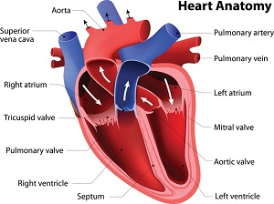
NS Heart Involvement
HEART 101

Slide 4
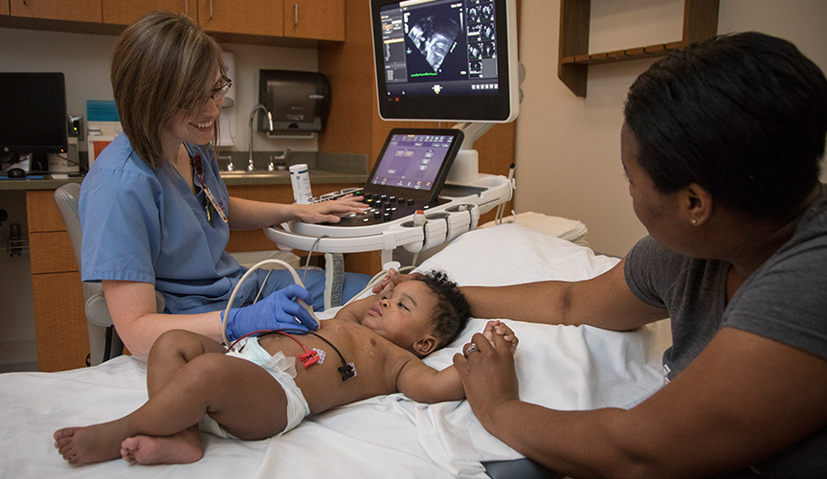
NS Heart Involvement
ECHOCARDIOGRAM

Slide 5
NS Heart Involvement
FREQUENCY AND FLAVORS
Frequency
  80-90%
Flavors
  Congenital Heart Defects
    Heart Not Formed Correctly
  Heart Muscle Disease
    Hypertrophic Cardiomyopathy

Slide 6
NS Heart Involvement
FREQUENCY OF FLAVORS
Pulmonary Valve Stenosis 40%
Hypertrophic Cardiomyopathy 10%
Aortic Coarctation 09%
Secundum Atrial Septal Defect 08%

Slide 7
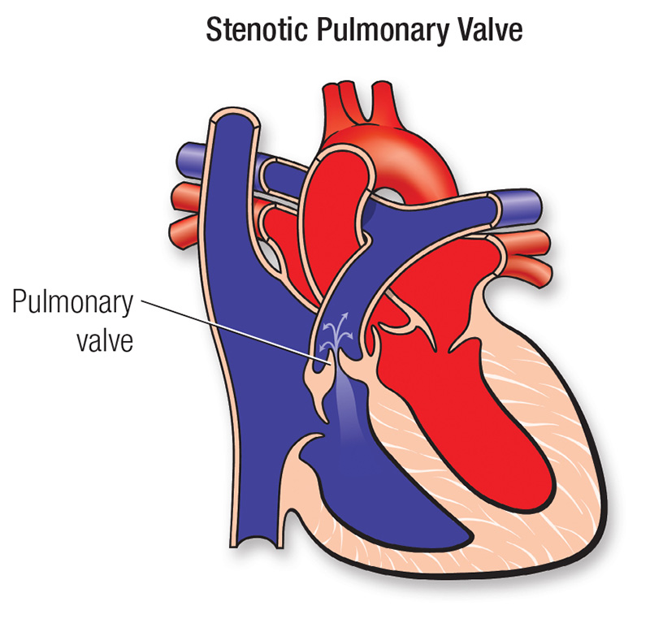
NS Congenital Heart Disease
PULMONIC STENOSIS

Slide 8
NS Congenital Heart Disease
PULMONIC STENOSIS
Severity
  Mild
  Moderate (35-70 mm Hg)
  Severe (>70 mm Hg)
Effects
  Mild: Murmur Only
  Moderate: Exercise Limitations
  Severe: Sick Neonates

Slide 9

NS Congenital Heart Disease
PULMONIC STENOSIS

Slide 10
NS Congenital Heart Disease
PULMONIC STENOSIS
Treatment
  Mild: Observation
  Moderate-Severe
    Catheterization
    Surgery

Slide 11
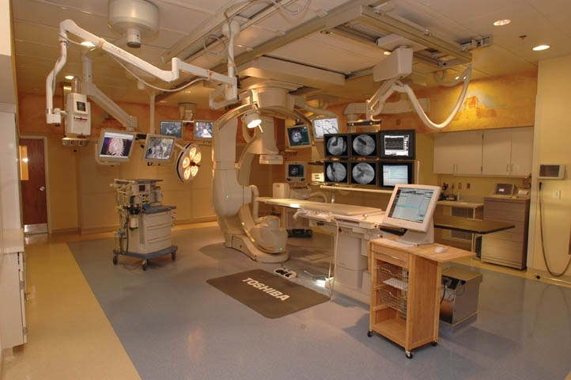
Heart Catheterization

Slide 12

Heart Catheterization

Slide 13

Heart Catheterization

Slide 14
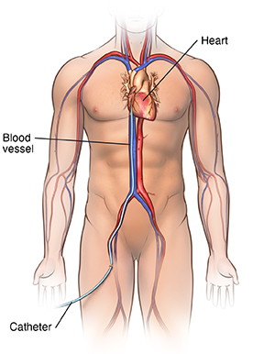
Heart Catheterization

Slide 15
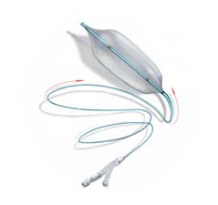
NS Congenital Heart Disease
PULMONIC STENOSIS

Slide 16
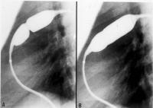
NS Congenital Heart Disease
PULMONIC STENOSIS

Slide 17
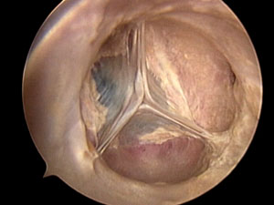
NS Heart Involvement
PULMONARY VALVE

Slide 18
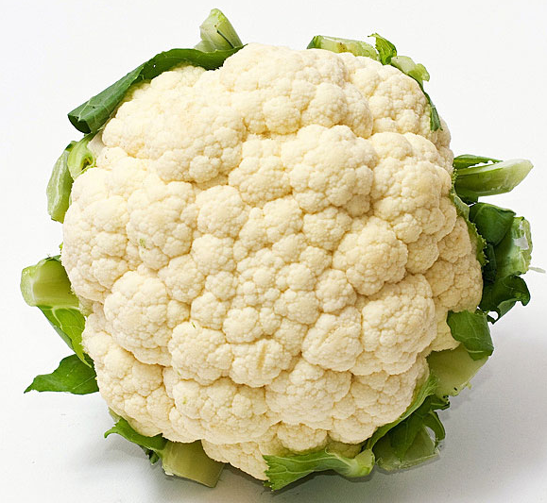
NS Heart Involvement
DYSPLASTIC PULMONARY VALVE

Slide 19
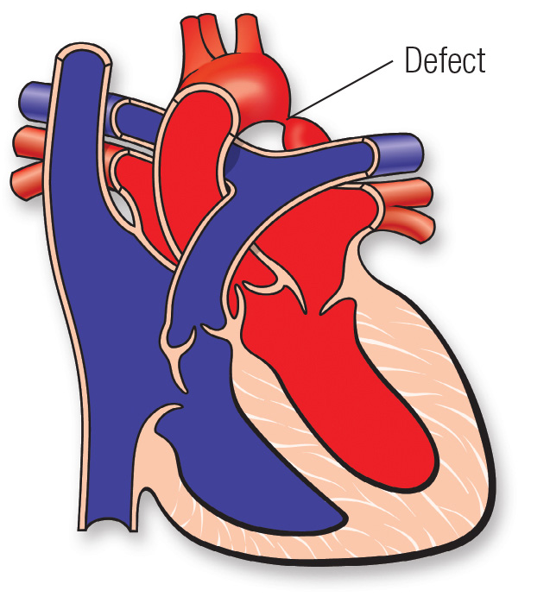
NS Congenital Heart Disease
AORTIC COARCTATION

Slide 20
NS Congenital Heart Disease
AORTIC COARCTATION
Severity
  Mild-Moderate
    Variable Presentation
    Surgery
  Severe-Critical
    Present as Newborns
    Stabilize, Then Surgery

Slide 21
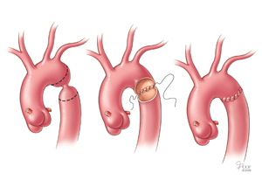
NS Congenital Heart Disease
AORTIC COARCTATION

Slide 22
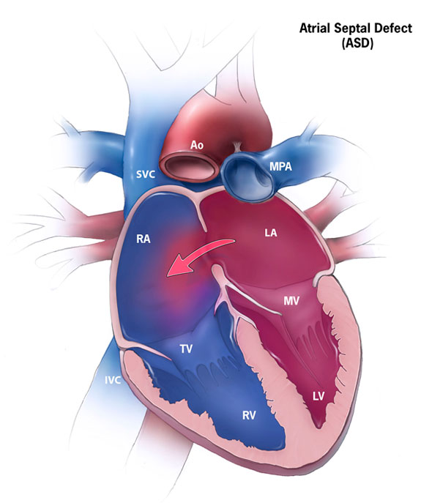
NS Congenital Heart Disease
ATRIAL SEPTAL DEFECT

Slide 23
NS Congenital Heart Disease
ATRIAL SEPTAL DEFECT
Size
  Tiny- Small
    No Symptoms
    Can Close Spontaneously
  Medium-Large
    Symptoms Rare in Childhood
    Need Closure

Slide 24
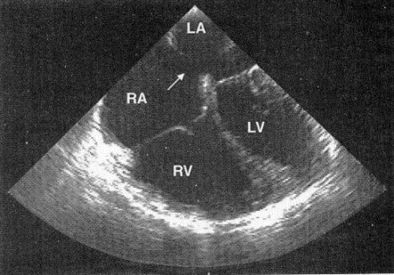
NS Congenital Heart Disease
ATRIAL SEPTAL DEFECT

Slide 25
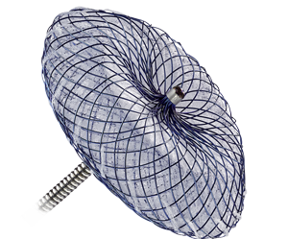
NS Congenital Heart Disease
ATRIAL SEPTAL DEFECT

Slide 26
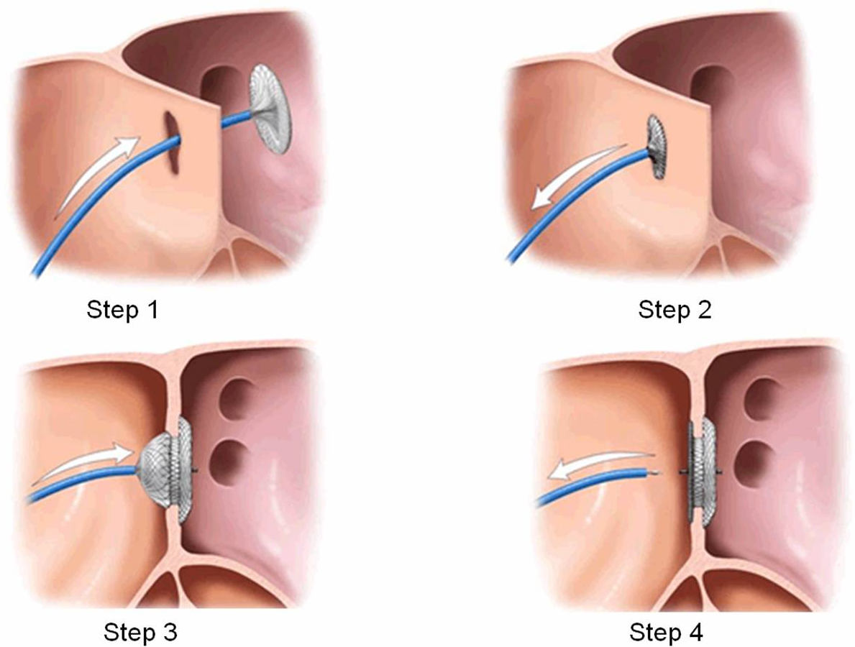
NS Congenital Heart Disease
ATRIAL SEPTAL DEFECT

Slide 27
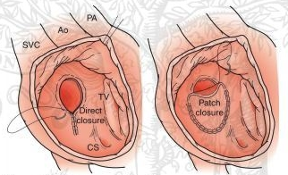
NS Congenital Heart Disease
ATRIAL SEPTAL DEFECT

Slide 28
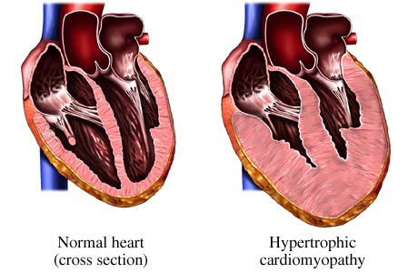
NS Heart Muscle Disease
HYPERTROPHIC CARDIOMYOPATHY

Slide 29
NS Heart Muscle Disease
HYPERTROPHIC CARDIOMYOPATHY
Severity
  Variable
    No Symptoms
    Congestive Heart Failure
  Onset
    Fetal, Newborn, Infant

Slide 30
NS Heart Muscle Disease
HYPERTROPHIC CARDIOMYOPATHY
Standard Treatment
  None
  Medical
    Various Types of Drugs
    For Symptoms, Not Cure
  Surgical
    For Symptoms, Not Cure

Slide 31
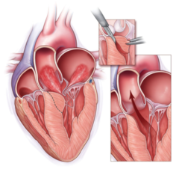
NS Heart Muscle Disease
HYPERTROPHIC CARDIOMYOPATHY

Slide 32
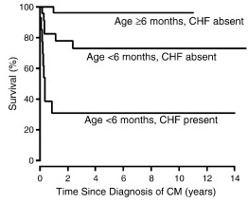
NS Heart Muscle Disease
HYPERTROPHIC CARDIOMYOPATHY

Slide 33
NS Heart Involvement
TYPICAL FOLLOW-UP
Baseline
  Exam, ECG, Echocardiogram
Normal Baseline
  Annual until 3, then 5, 10, 15
Hypertrophic Cardiomyopathy
  Infants- Carefully
  Older- Annually
Congenital Heart Disease
  Variable

Slide 34
NS Heart Involvement
SPECIAL CONSIDERATIONS
Pediatric Cardiology
  “Noonan Expert” Not Necessary
Pulmonary Valve Stenosis
  Less Success with Balloon Treatment
Hypertrophic Cardiomyopathy
  Use of the Cancer Drug Trametinib
Pre-Procedure
  Evaluation for Bleeding
Anesthesia
  Typical Risk

Slide 35


Slide 36
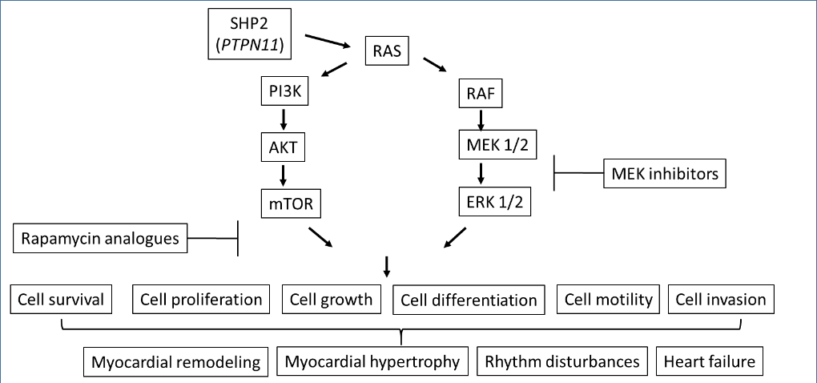
NS Heart Disease
TREATMENT POSSIBILITIES

Slide 37
NS HCM
TRAMETINIB
2 Infants with NS with Severe HCM in 2017
  Both with RIT1 Mutations
High-Dose Beta Blockers
Oral Trametinib
Compassionate Usage Basis
Results: Both Survived and Improved

Slide 38
RASopathies
TRAMETINIB TREATMENT
2017 2 Babies treated with trametinib for NS/HCM
2018 Discussions with Novartis
2019 JACC letter published
2019-Now Inquiries from biotech/pharm, VCs re: MEKi
2022-23 Day One Pharmaceutical/Pimasertib
2023 Novartis ends trametinib access program
2025 Retrospective review published

Slide 39
NS MEKi Treatment
Questions
Does it really work?
For whom does it work?
  Ages?
  Genes?
For what aspects of NS does it work?
What are the side effects in patients with NS?

Slide 40


