Slide 1


Disordered Bleeding in Noonan Syndrome
NSF Conference 2026
Benjamin Briggs, MD
Associate Professor Uniformed Services University
Naval Medical Readiness and Training Command Rota Spain

Slide 2
Disclosures
No financial disclosures
No conflicts of interest
The views expressed in this talk are those of the author and do not necessarily reflect the official policy or position of the Department of the Navy, Department of War, the Uniformed Services University, or the US Government

Slide 3
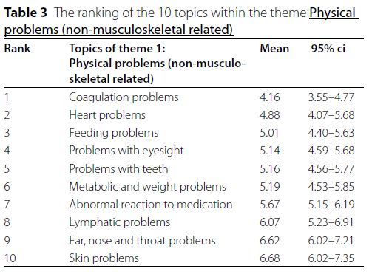
Why?
It is important to you!
Tiemens et al. Orphanet J Rare Disease 2023
UNCLASSIFIED
Notes:
80 patients and relatives were queried about their concerns regarding NS. The #1 theme was physical problems of which coagulation problems was #1. Highest priority ranked as #1 and up to last category, so lower mean is higher priority

Slide 4

Why?
Evaluation and treatment makes a difference!
Risk Reduction 6.2% (95% CI 2.3% – 10.1%)
Treat or screen 16 to prevent one bleeding complication (95% CI 9.9 – 43.9).
Majority of patients had either no or incomplete evaluation, 59/101 (58.4 %).
Briggs et al. J Peds. 2020

Slide 5
Goals
Empowered with knowledge
Who
What
When
Why
Equipped for advocacy
Where should we focus future efforts
Notes:
Evaluation NOT testing because it’s a clinical diagnosis

Slide 6
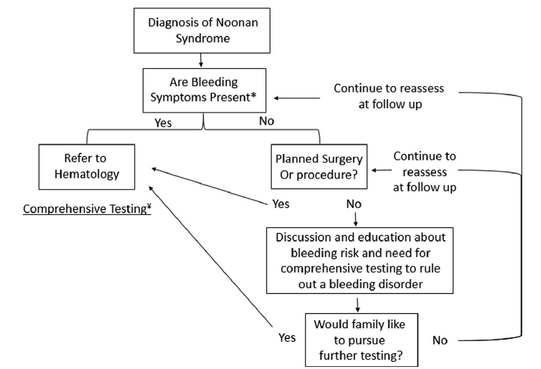
- Factor activities based on a prolonged PT and/or aPTT value
- Fibrinogen activity
- VWF activity and antigen
- Factor VIII activity
- Platelet aggregation studies
- Factor XIII activity and PAI-1 antigen if bleeding symptoms and above is negative
Bruno et al. J Peds. 2023

Slide 7
Who ?
- Factor activities based on a prolonged PT and/or aPTT value
- Fibrinogen activity
- VWF activity and antigen
- Factor VIII activity
- Platelet aggregation studies
- Factor XIII activity and PAI-1 antigen if bleeding symptoms and above is negative
Bruno et al. J Peds. 2023

Slide 8
What ?
- Factor activities based on a prolonged PT and/or aPTT value
- Fibrinogen activity
- VWF activity and antigen
- Factor VIII activity
- Platelet aggregation studies
- Factor XIII activity and PAI-1 antigen if bleeding symptoms and above is negative
Bruno et al. J Peds. 2023

Slide 9
When ?
- Factor activities based on a prolonged PT and/or aPTT value
- Fibrinogen activity
- VWF activity and antigen
- Factor VIII activity
- Platelet aggregation studies
- Factor XIII activity and PAI-1 antigen if bleeding symptoms and above is negative
Bruno et al. J Peds. 2023

Slide 10
- Factor activities based on a prolonged PT and/or aPTT value
- Fibrinogen activity
- VWF activity and antigen
- Factor VIII activity
- Platelet aggregation studies
- Factor XIII activity and PAI-1 antigen if bleeding symptoms and above is negative
Bruno et al. J Peds. 2023

Slide 11
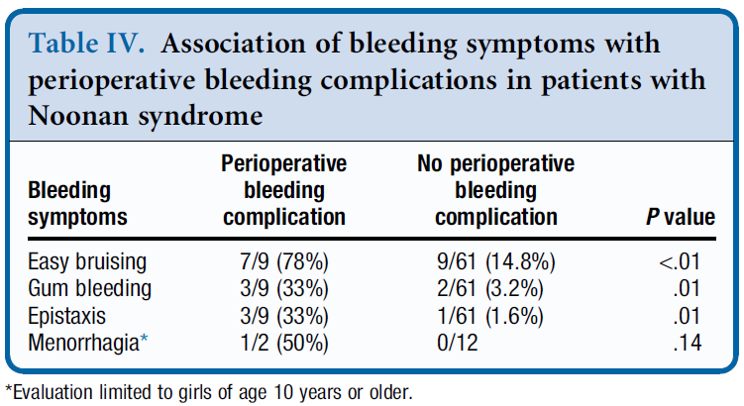
Importance of bleeding symptoms
Briggs et al. J Peds. 2020

Slide 12
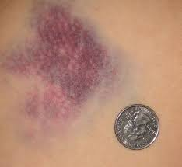
Bruising
Easy or excessive bruising?
  Large size
  Palpable
  Multiple
  Occur with limited trauma
  On unexposed surfaces
Severe bruising with vaccines?
Hematomas?
https://www.google.com/url?sa=i&url=http%3A%2F%2Fnoticeverything.blogspot.com%2F2010%2F04%2Fmy-first-roller-derby-bruise.html&psig=AOvVaw1JZbfRPVoqZAO5iPtQF0oR&ust=1641923556977000&source=images&cd=vfe&ved=0CAkQjhxqFwoTCNDi0JLgp_UCFQAAAAAdAAAAABAJ

Slide 13
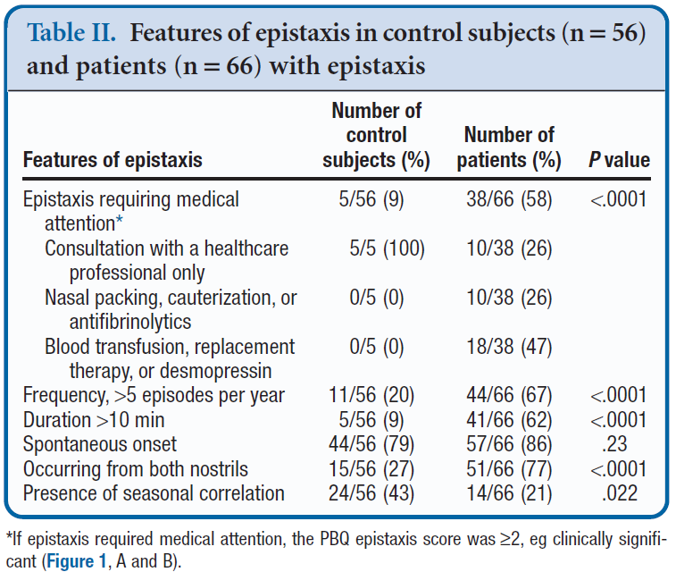
Nose Bleeds = Epistaxis
Number of bleeds per year?
How long do they last?
Both or single nostril?
Seasonal correlation?
How does it stop?
  Spontaneous?
  With pressure?
  Medical Intervention?
Stokhuijzen et al. J Peds. 2018; 193:183-189

Slide 14
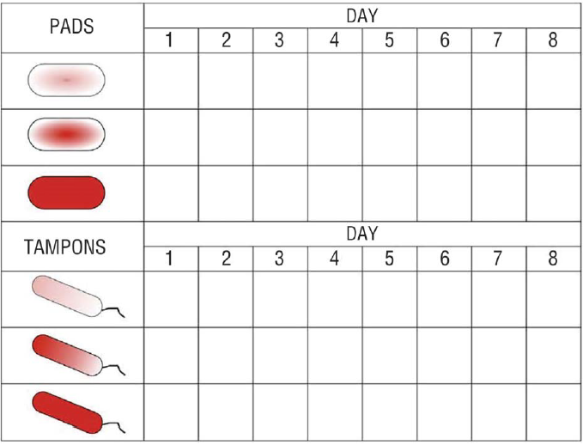
Heavy Periods = Menorrhagia
Duration of menses > 7 days
Bleeding through pads or tampons
More than 6 pads/tampons per day
Needing change every 1-2 hours
Passing large clots
Needing to get up at night to change tampon or pad
Score > 100 = Sensitivity 80%, PPV 72% for bleeding disorder ^{1,2}
Notes:
Philip et al. Am J. Obstet Gynecol. 2008
AGOG opinion. Obstetrics & Gynecology. September 2019

Slide 15
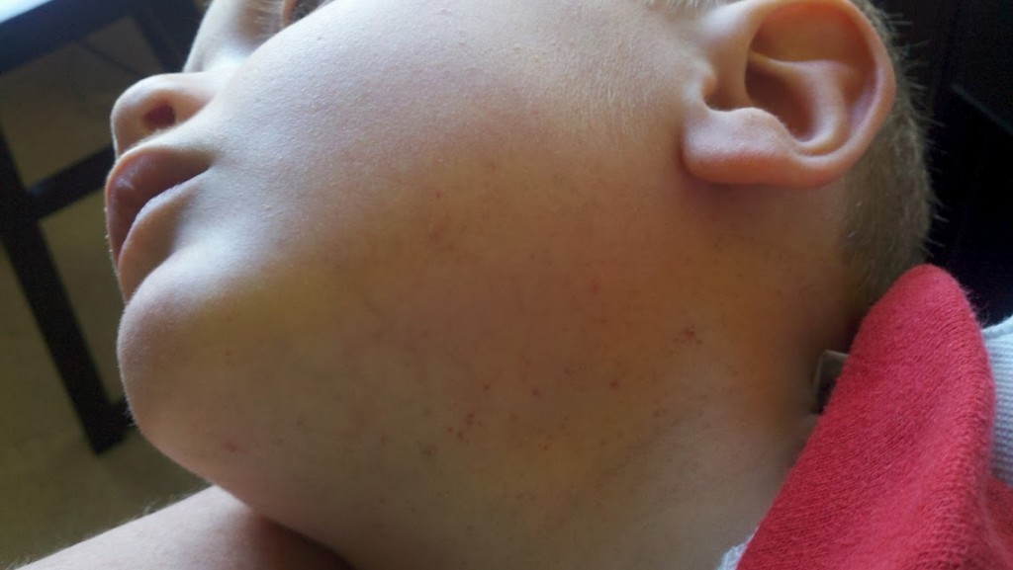
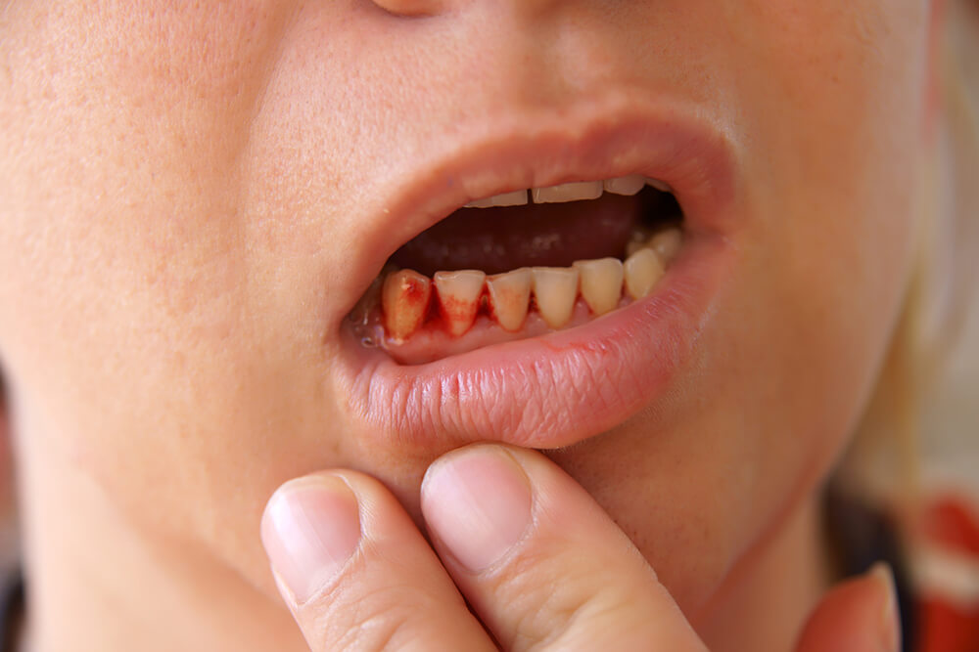
Other symptoms
Petechiae?
Gum bleeding?
Bleeding with tooth loss or eruption?
Umbilical stump bleeding?
Prolonged bleeding after injury?
Post-operative bleeding?
Bleeding after circumcision?
https://insteadofthedishes.com/blog/2012/07/18/what-petechia-looks-like/comment-page-1/
https://www.google.com/url?sa=i&url=https%3A%2F%2Fwww.absolutedental.com%2Fblog%2Fwhy-are-my-gums-bleeding%2F&psig=AOvVaw0yXnThuf8-JxZqNAwFyFI4&ust=1641924220333000&source=images&cd=vfe&ved=0CAkQjhxqFwoTCPCYzsLip_UCFQAAAAAdAAAAABAD

Slide 16
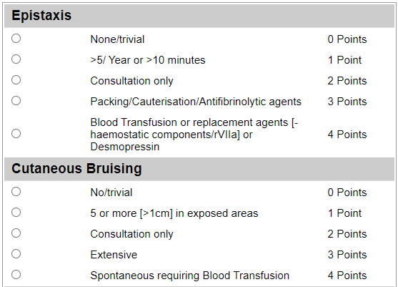
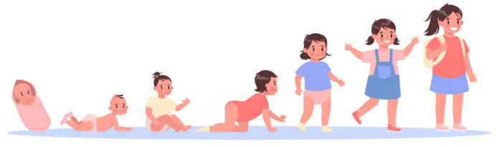
Challenges of using symptoms alone
Clinical tools developed to quantify bleeding symptoms
  ISTH-BAT →
Requires hemostatic challenge
  Not enough time to have developed in small children
https://www.onlinepsychologydegree.info/lists/5-theories-of-child-development/
https://practical-haemostasis.com/Clinical%20Prediction%20Scores/Formulae%20code%20and%20formulae/Formulae/Bleeding-Risk-Assessment-Score/ISTH_BAT_score.html
Notes:
https://practical-haemostasis.com/Clinical%20Prediction%20Scores/Formulae%20code%20and%20formulae/Formulae/Bleeding-Risk-Assessment-Score/ISTH_BAT_score.html

Slide 17
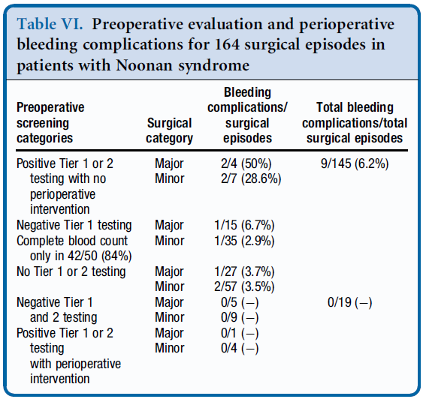
Why before surgery?
Briggs et al. J Peds. 2020

Slide 18

Why this testing recommendation ?
Bleeding disorders are common
No genotype-phenotype correlation
Multiple causes
  Testing requires a lot of blood
  Results require interpretation

Slide 19
How common are bleeding disorders in NS?
Reports suggest 50-89% of patients have disordered bleeding
    Most are mild-moderate bleeding tendencies
    Rare severe hemorrhages
Uncertainty due inconsistency in defining a bleeding disorder
    Most papers now define it as:
        Positive history of bleeding
        AND/OR
        Abnormal hemostatic laboratories
Uncertainty due to potential referral bias

Slide 20
Is there a correlation with genotype?
Correlation between genotype (genetics) and phenotype (what patient experiences) varies from 14 to 60%.
Therefore NS genetics do not completely correlate with, nor predict, bleeding risk.
Multiple bleeding abnormalities and variability in patient presentations are hard to attribute to a single gene defect.

Slide 21
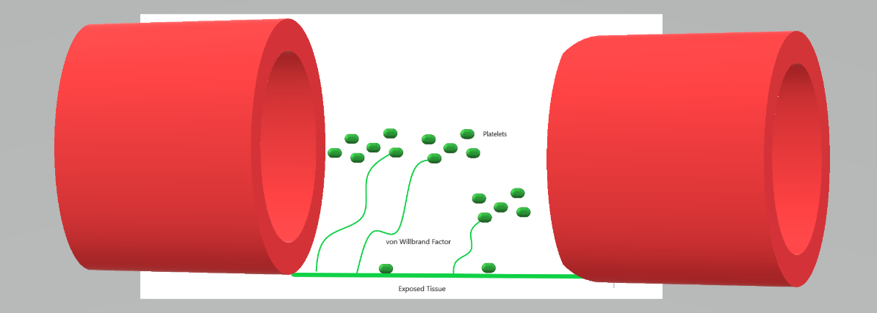
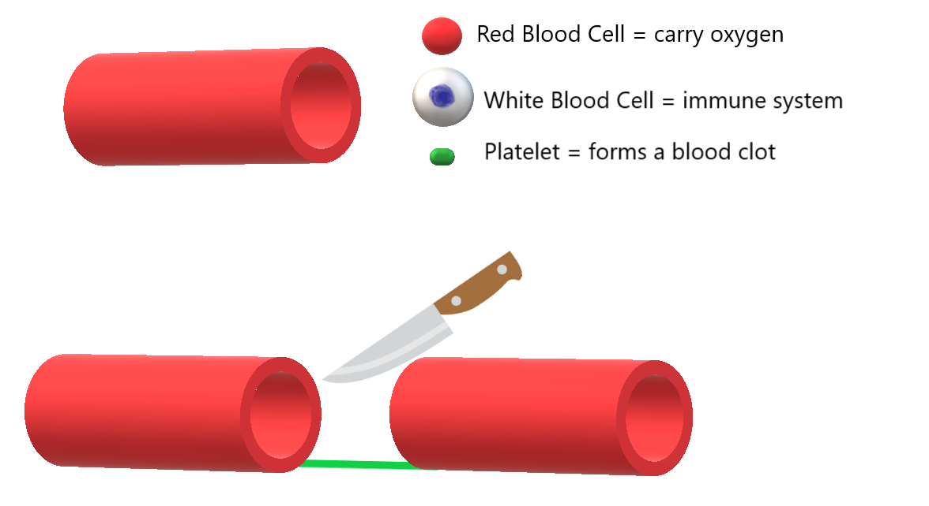
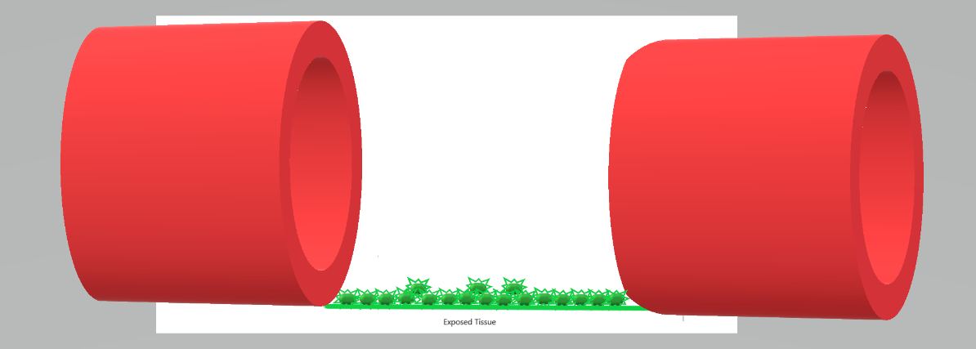
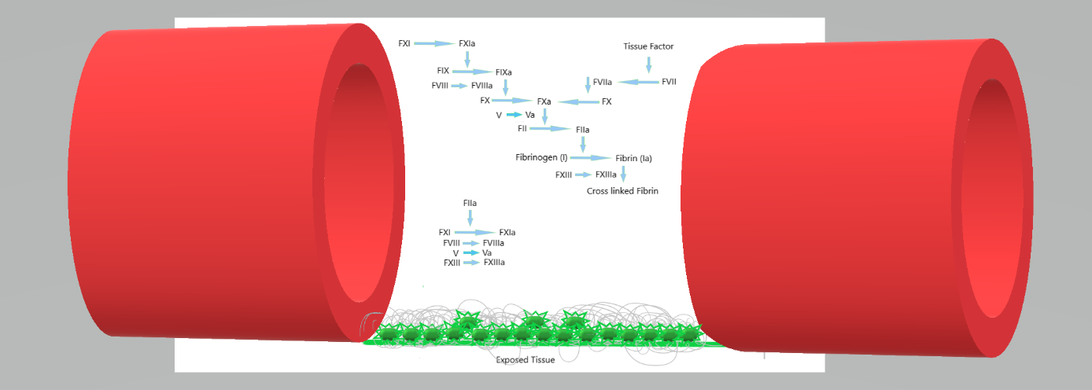
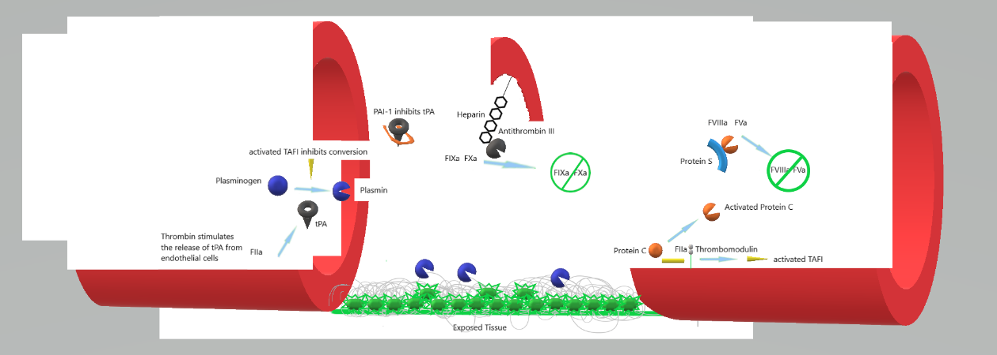
Hemostasis refresher

Slide 22
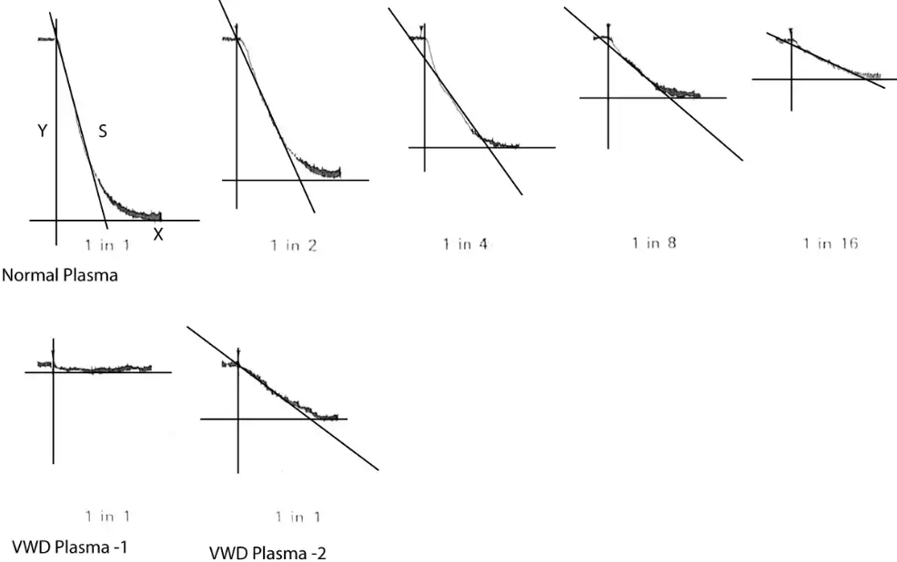
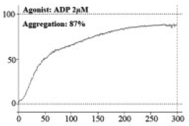
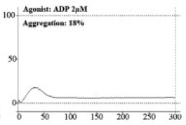
Primary Hemostasis
Platelet Function Defects
von Willebrand disease
Di Candia et al. 2021: 65%
Ruiz-Llobet et al. 2020: 68%
Artoni et al. 2014: 83%
Okur Acar et al. 2024: 41%
Bruno et al. 2023: 25%
Nugent et al. 2018: 5%
Control
NS
Ruiz-Llobet et al. Thromb Haemost. 2020
https://practical-haemostasis.com/Factor%20Assays/vwf/VWF%20Functional%20Assays/vwf_rco_assay.html

Slide 23
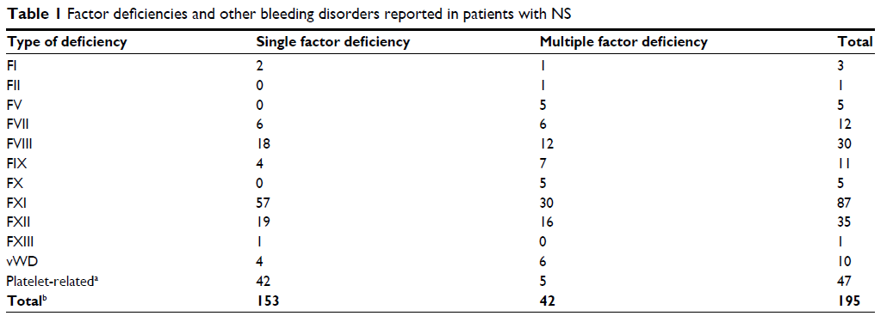
Secondary Hemostasis – Factor Deficiencies
Nugent et al. J Blood Med 2018

Slide 24
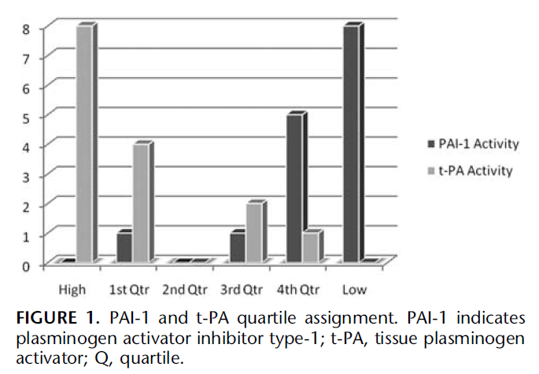
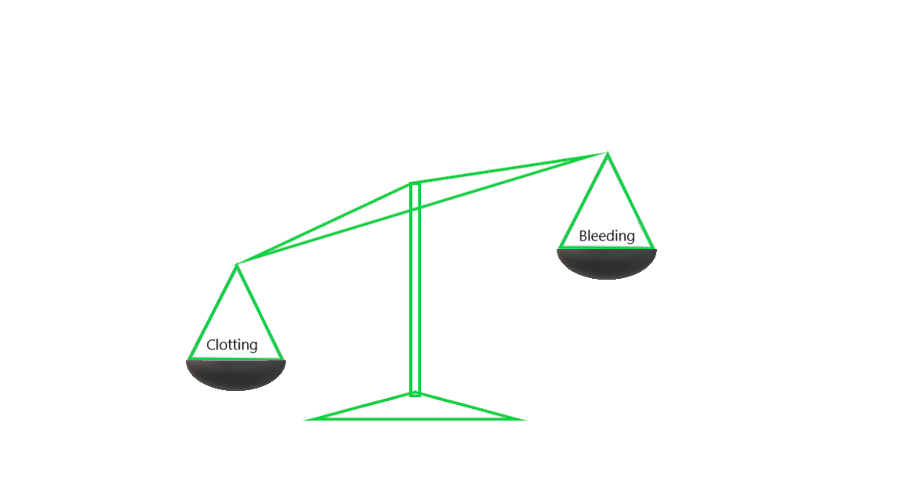
Fibrinolysis – imbalanced

Slide 25
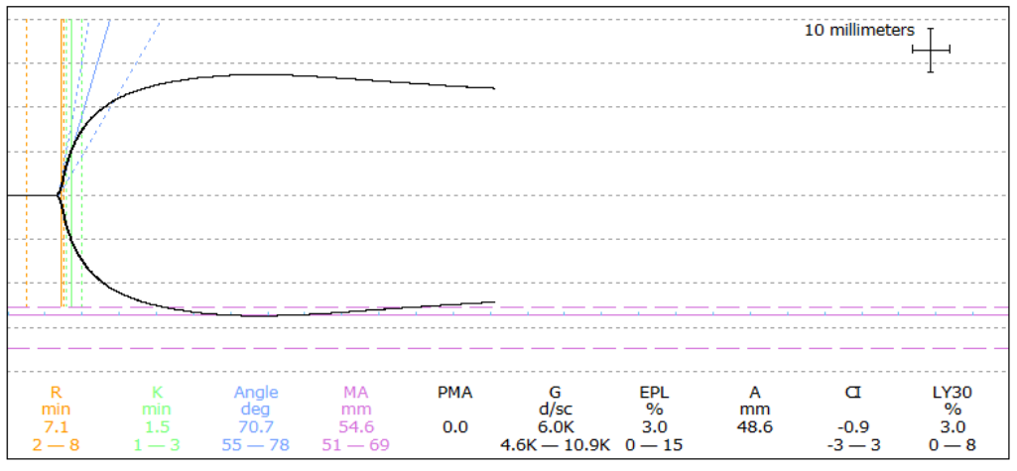
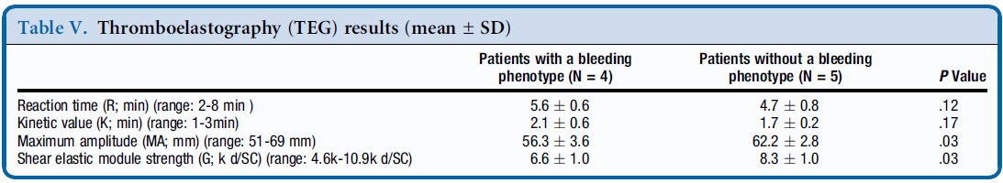
Thromboelastography (TEG)
Bruno et al. J Peds. 2023

Slide 26
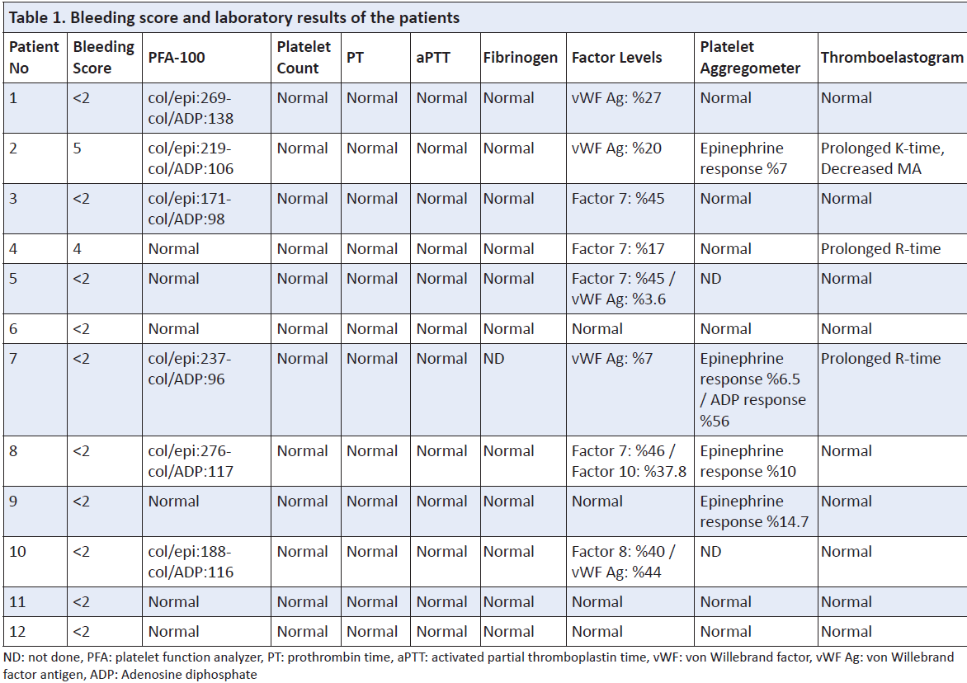
Thromboelastography (TEG)
Okur Acar et al. Trends in Pediatrics. 2024
Notes:
Small numbers make it challenging to generalize

Slide 27
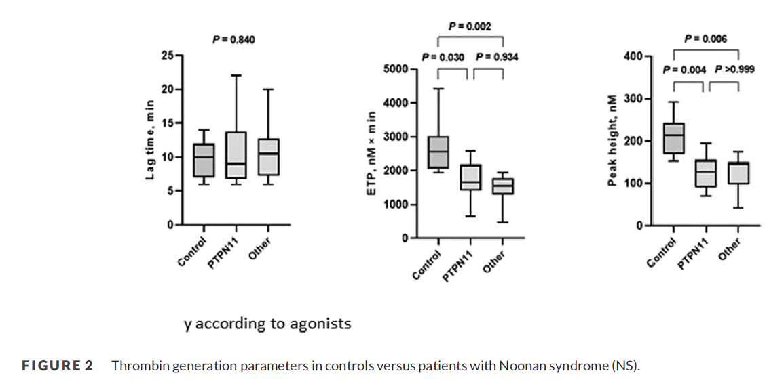
Thrombin Generation (TG) Test
Twenty-four children with NS
Bleeding complications in 15%
Abnormal platelet function 50%
Lower TG compared with controls
  No correlation between bleeding symptoms and TG results
Barg et al. Pedtr Blood Cancer. 2023
Notes:
Notably, no significant correlation between BAT score and TG results was observed in our study.

Slide 28
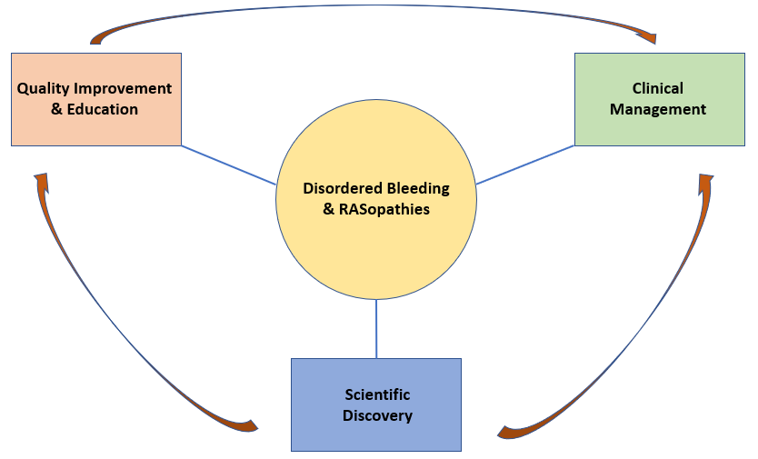
Next steps:

Slide 29
New approach to clinical studies
Bleeding Symptoms?
1. Clinical classification:
Bleeding symptoms and abnormal labs
Bleeding symptoms and normal labs
No bleeding symptoms and abnormal labs
No bleeding symptoms and normal labs
2. Novel coagulation testing
3. Are bleeding risks tissue specific?
Yes
No
A
C
Yes
Abnormal Labs?
B
D
No
Notes:
Dividing patients into these 4 categories would allow for comparisons to determine if certain laboratory findings are more accurate in prediction which patients will have bleeding complications

Slide 30
Bleeding disorder - Static or Dynamic?
Platelet Function Defects
Factor deficiencies
Bellio et al. 2019
Mice heterozygous for D61G mutation in SHP2 (PTPN11) had a proximal collagen receptor signaling defect in platelets
Not like hemophilias
  Mutations in genes of respective clotting factors
Abnormality in clotting factor production
  Developmental Hemostasis
  Acute phase response
Notes:
Bellio et al. Blood. 2019

Slide 31
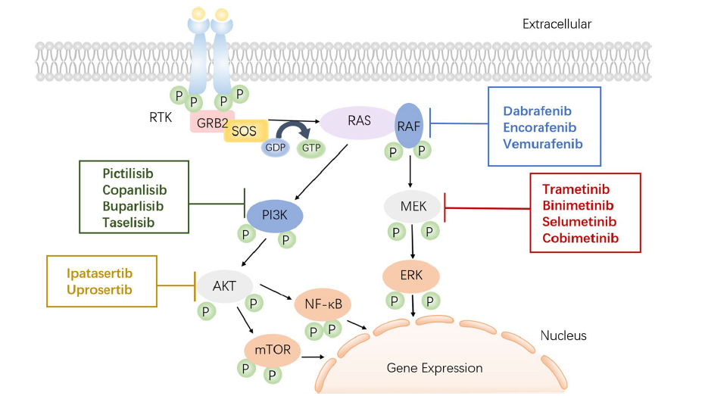

Can it be modified?
Chakraborty et al. 2022
15 yo male with NS
Refractory pulmonary and gastrointestinal hemorrhage
Bleeding stopped upon initiation of selumetinib
Notes:
Chakraborty et al. 2022 Pediatrics

Slide 32

Questions?
Notes:
https://spendmatters.com/2019/05/24/dont-forget-the-big-4-questions-to-ask-during-any-mega-acquisition/

