Slide 1
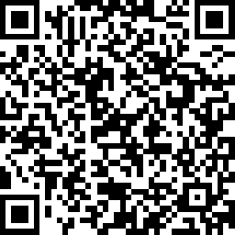
Why DoesN’T My Doctor Know Anything About Noonan Syndrome?
Dr. Keir A. Shiels MA MB BChir (Cantab) FRCPCH FAcadMEd

Slide 2
WHO’S THERE?

Slide 3
It was a bright cold day in April and the clocks had just struck thirteen

Slide 4
Mr. and Mrs. Dursley of number four, Privet Drive, were proud to say that they were perfectly normal, thank you very much.

Slide 5
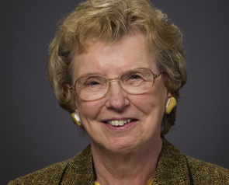
1962
Associated non-cardiac malformations in children with congenital heart disease

Slide 6
1969
Hypertelorism with Turner Phenotype

Slide 7
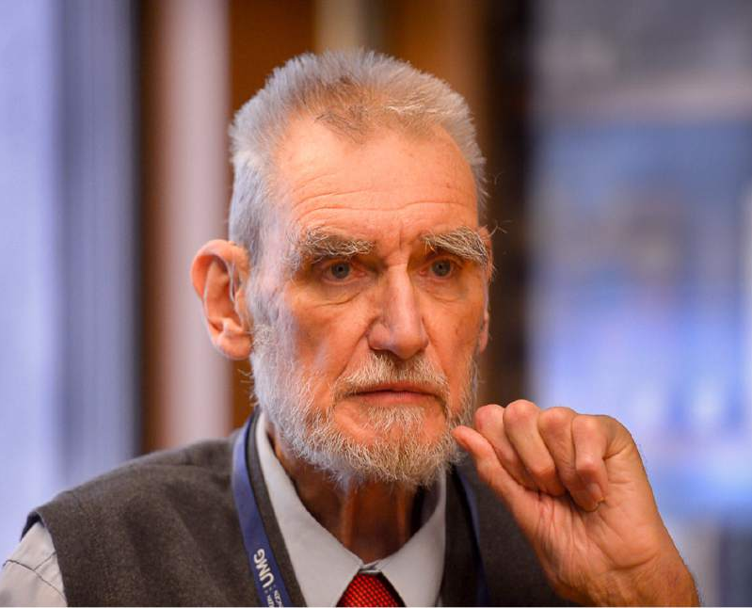
1971
Noonan Syndrome
John Opitz, Symposium of Cardiovascular defects

Slide 8
19 Patients
PULMONARY STENOSIS &
Short Stature
Facial Features
Mild Learning Needs
Undescended Testes

Slide 9
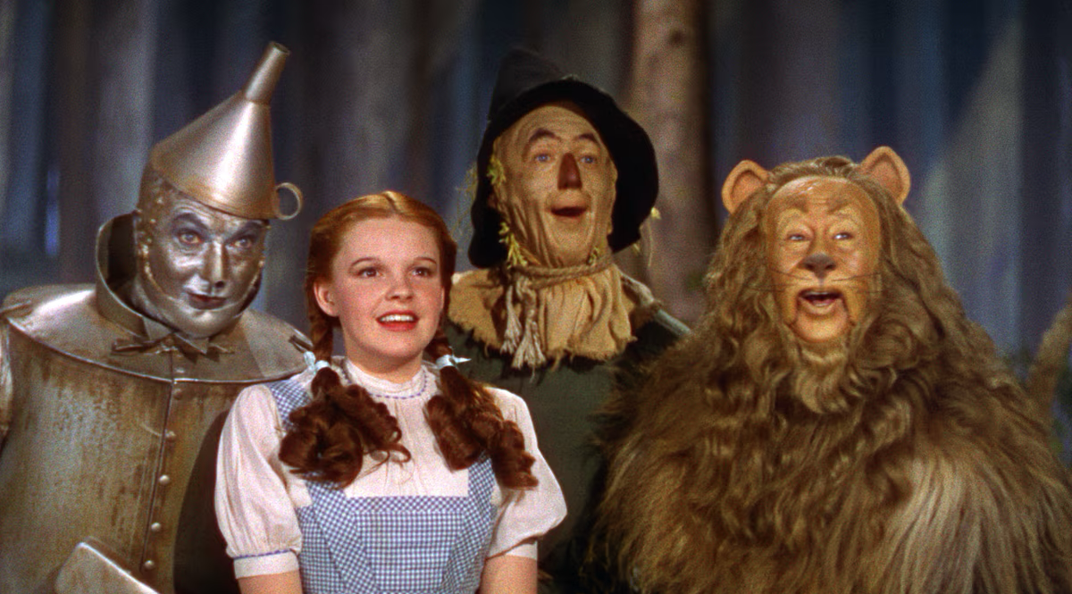

Slide 10
The original pattern-recognition Definition:
Turner-type dysmorphic Features
Pulmonary Stenosis
Noonan

Slide 11
Problems – In Literature, textbooxs and exams
Seen as a cardiac condition with associations
The “Male Turners” issue
Identification of a pattern: focus on universally shared characteristics, starting with the heart
No mention of leg pains or feeding difficulties
Understanding of neurodiversity in its infancy

Slide 12
The story started in the wrong place

Slide 13
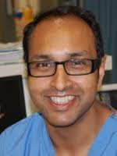
28 Years Later… 1999
25 Patients
“Gastroduodenal motor activity was reminiscent of 32-35 week preterm patterns. The feeding difficulties appear to resolve as gut motility matures. In Noonan's syndrome, feeding problems appear to be the result of delayed gastrointestinal motor development.”

Slide 14
Noonan Syndrome 1999: Opportunity to look into…
Facial features
Vomiting
Short Stature
Fussy Eating
Hearing Difficulties
Pulmonary Stenosis
Learning Difficulties
Visual Problems
Leg Pains
Developmental Delay
Hypertrophic Cardiomyopathy
Hypermobility
Itchy Skin
Neurodiversity
Bleeding
Delayed Puberty
Lymphoedema
Scoliosis & Flat Feet

Slide 15
Something else came along

Slide 16
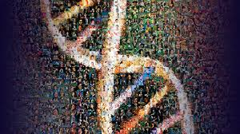
2000
Human Genome Project – “The gene for…”

Slide 17
GENES IDENTIFIED
2001
PTPN11
2006
KRAS
2007
SOS1
2007
RAF1
2013
RIT1

Slide 18
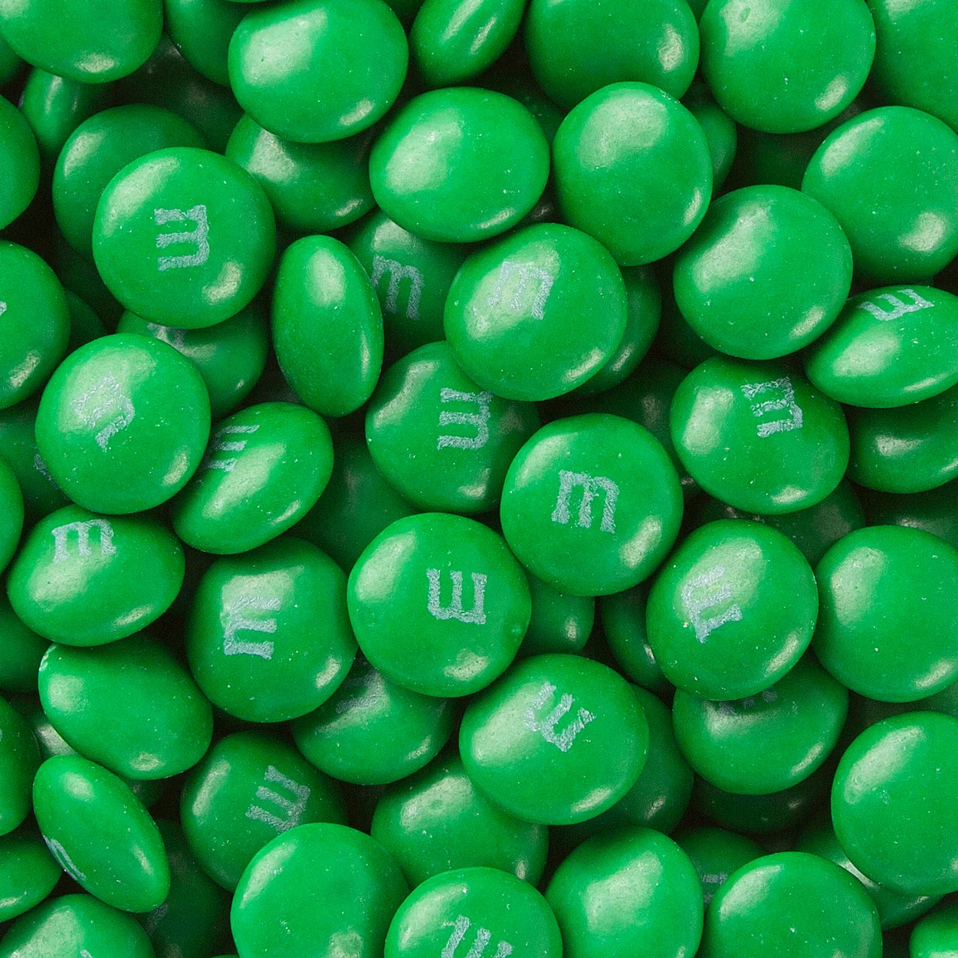
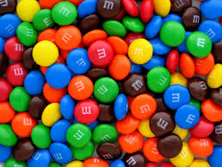
Cystic fibrosis
Noonan Syndrome

Slide 19


Genes in Diseases

Slide 20
Babies shouldn’t taste salty
That’s not a normal infection
That’s not a normal number of infections
That’s not a normal poo
That’s an established red flag
I have seen this before – let’s act!

Slide 21
All Babies Vomit
Murmurs are usually benign
Vomiting usually improves
Growing pains are common
Bad vomiting has an investigation & treatment pathway – Milk change, CMPA, Coeliac, Reflux
Babies catch up
I’ve seen this before, don’t worry.

Slide 22
“Do your reading”: Fractured Evidence
1660-1699:
10 scientific journals
1999:
100,000 scientific journals
2026:
30,000 medical science journals
2.2million papers a year
You used to be able to read everything
Why would an orthopedic spinal surgeon or a gastroenterologist read a cardiology journal?

Slide 23
Variety of Presentation & Variety of severity makes it hard to identify and hard to research

Slide 24
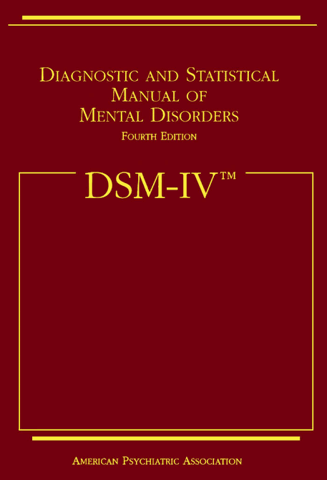
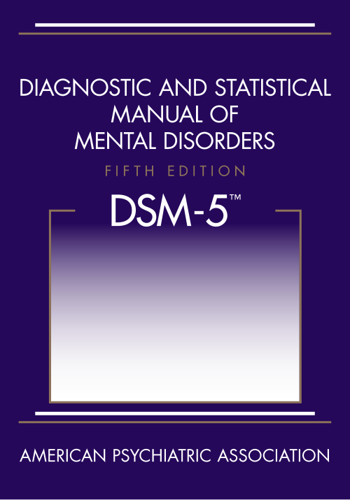
Perceived wisdom changes
1994
2013
ADHD and Autism

Slide 25
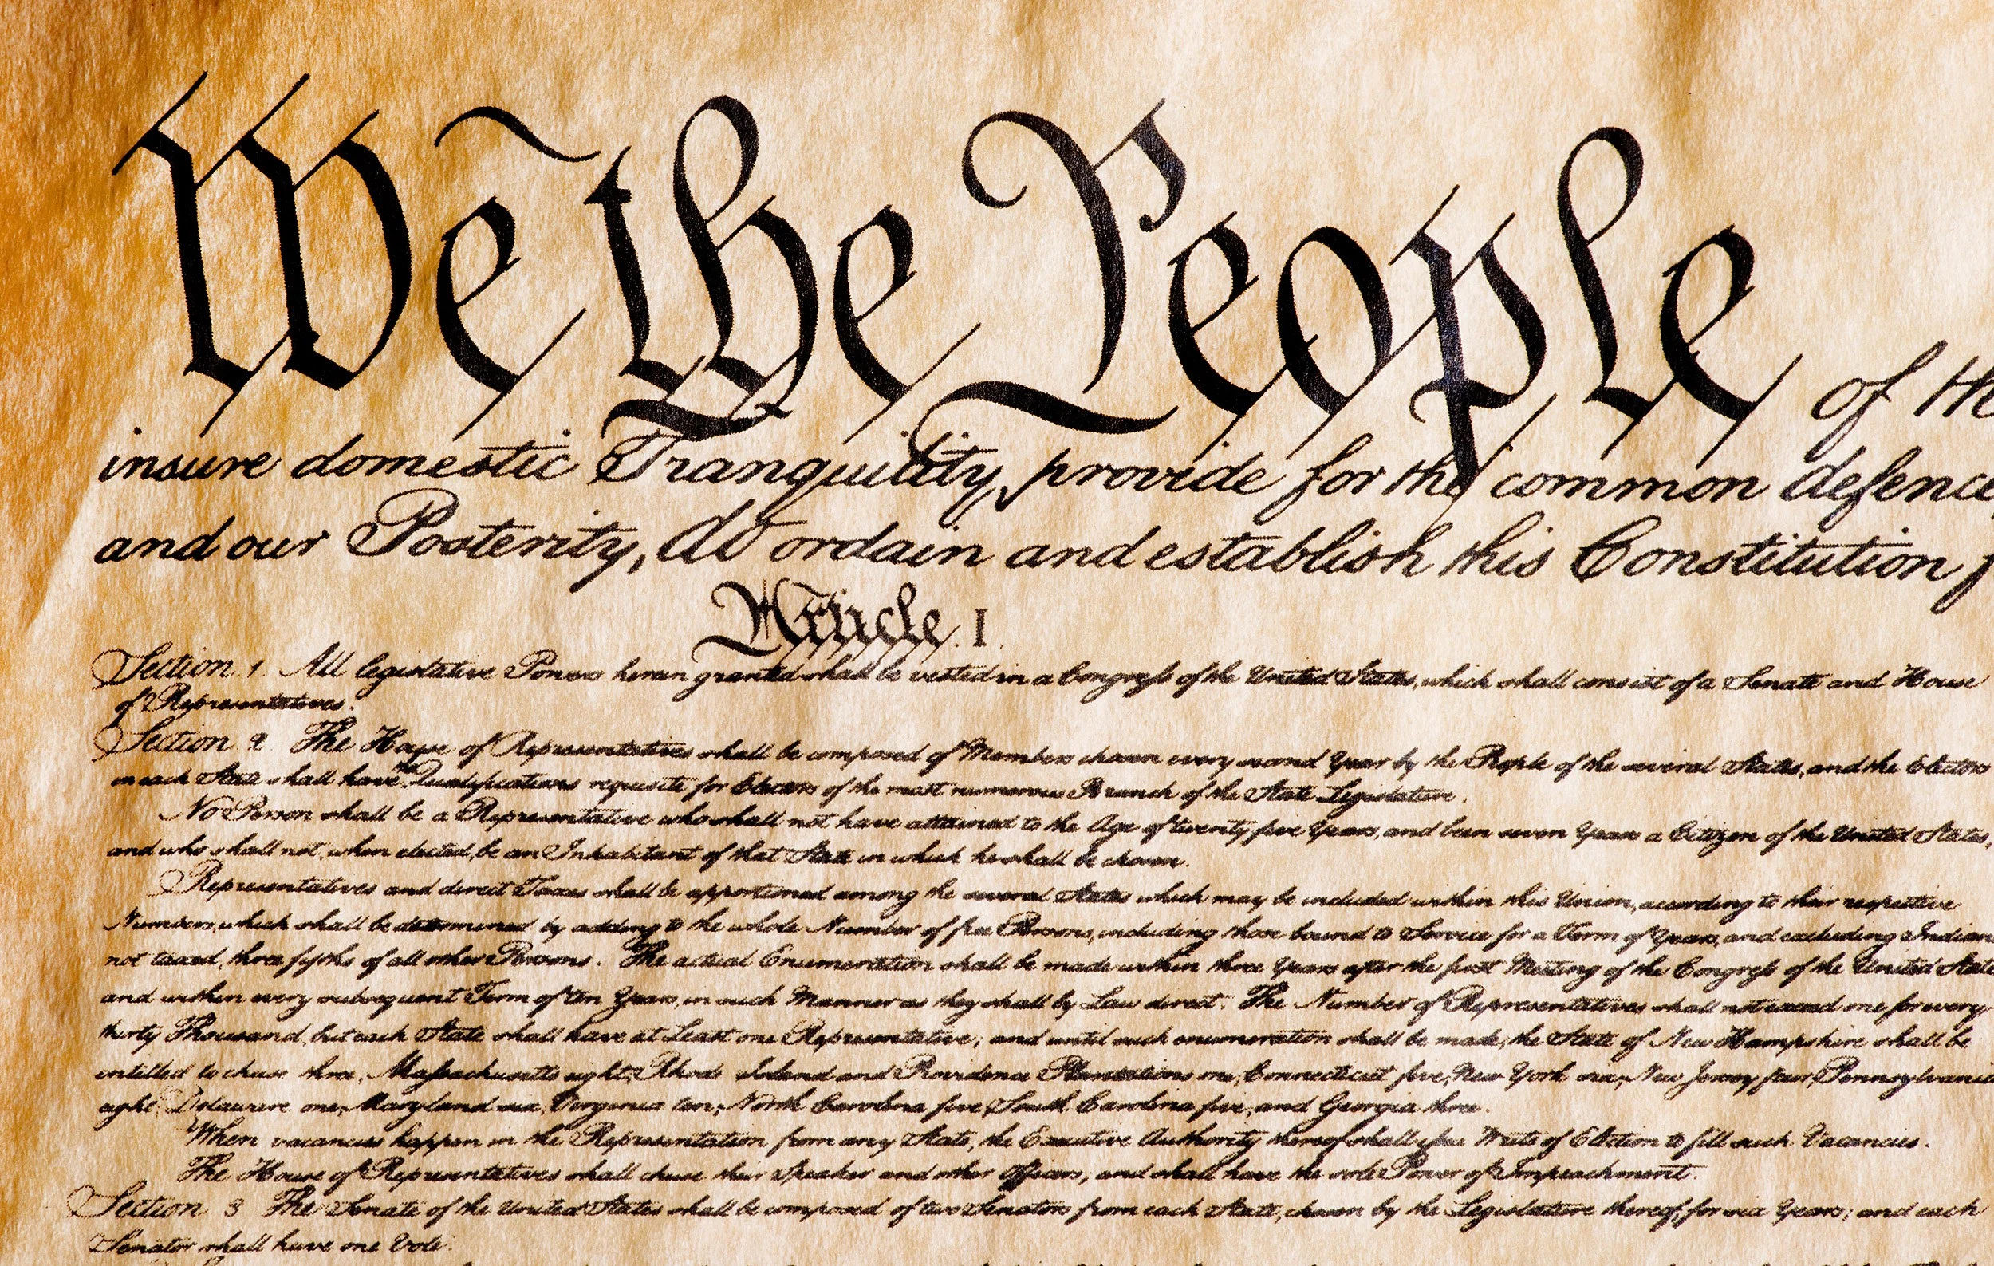
Once something’s written down as fact, it is very hard to change

Slide 26
We get things wrong.
And the only thing harder than doing science is undoing science.

Slide 27
Putting Noonan’s genie back in the bottle
Not a “Turner” phenotype
Not a Male Syndrome
Not “on Chromosome 12”
NOT A CARDIAC DISEASE
Not a Single gene

Slide 28
Cardiac Problems Should not Define Noonan Syndrome

Slide 29
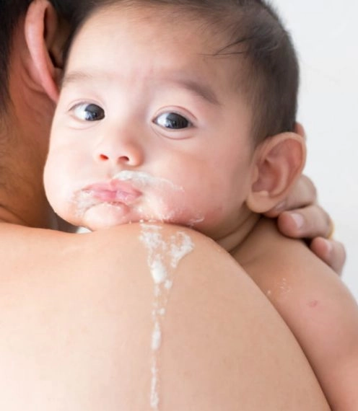
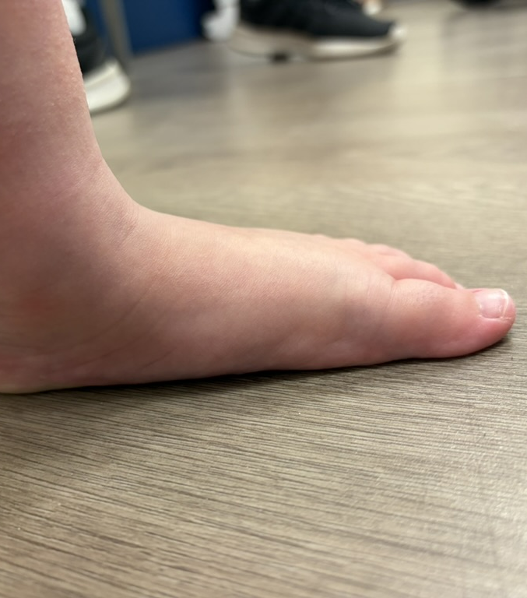
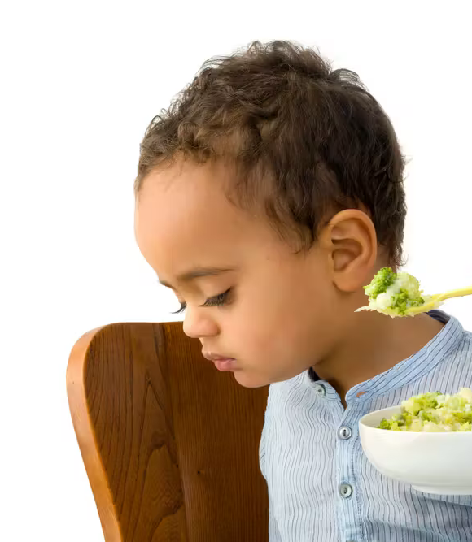
As common as pulmonary stenosis. Longer lasting.

Slide 30
Variety in Genetics, variety in presentation
There is no such thing as
“PTPN11 Noonan Syndrome”

Slide 31
Variety in Genetics, variety in presentation
There are at least 98 different
“PTPN11 Syndromes Noonan”

Slide 32
Should We focus less on genes for the big picture?
PTPN11: 90
RIT1: 14
LZTR1: 67
SOS1: 30
RAF1: 25
You would need 300 children in a study to include only one of each genetic mutation.
You would need 600 children in a study to have one of each gender
You would need 10,800 children in a study to have one child of each age of each gender
You would need 108,000 children in a study to be able to draw some basic comparisons
You would need to invite half a million children.
Or is each a “Rare Disease”?

Slide 33
Noonan Syndrome does not follow standard protocols

Slide 34
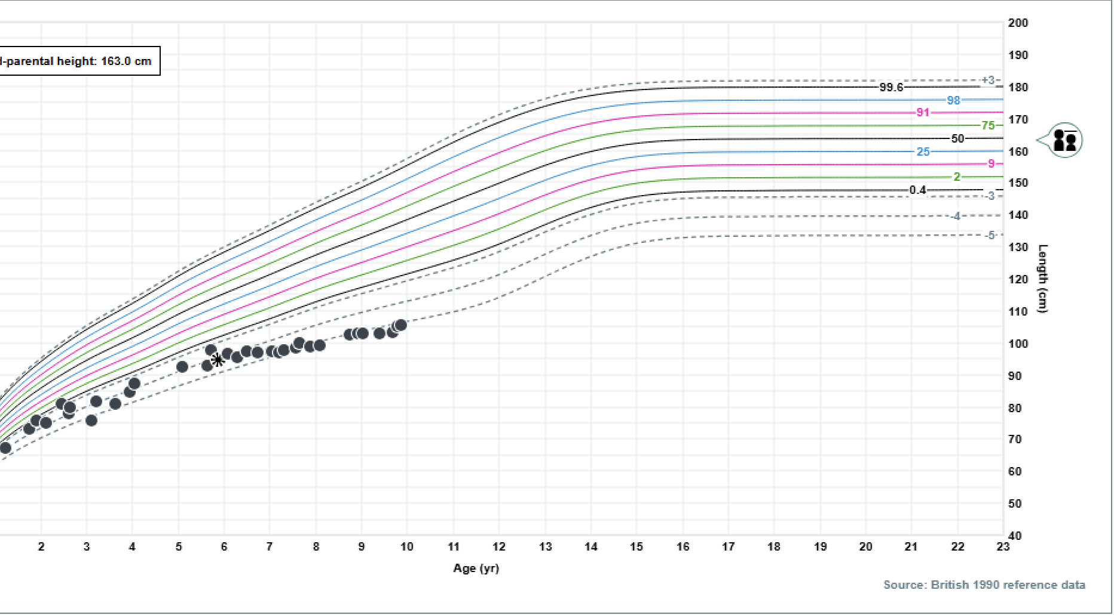

Slide 35
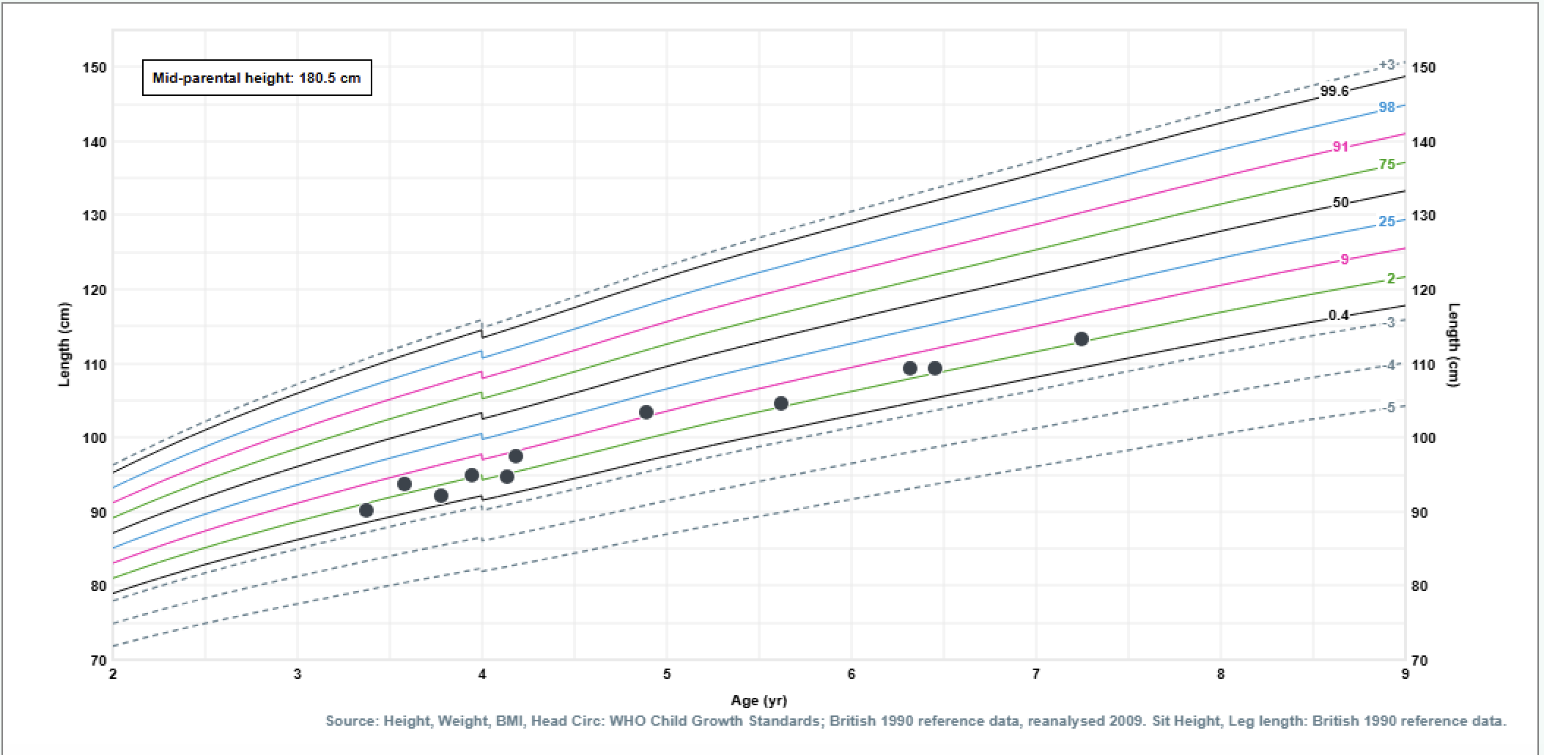
Jack Sanderson

Slide 36
You don’t know jack

Slide 37
Hearts, genes and heights
EASILY MEASURABLE
Easy to research
Matter most across the condition
High Stakes - stop children dying

Slide 38
Leg Pains, Appetite, Learning, Bleeding
HARD TO MEASURE
Hard to research
Matter most to those who have them
Different stakes – ease daily burden

Slide 39
Uncertainty: stop teaching wrong stuff!
36 Years of Cardiac Certainty
18 Years of re-evaluation
First defined
First named
1999
First expansion attempt
2001
First gene
2007
Confusion of genes
2013
Associated problems re-defined
Most recent genetics study
19 patients
150 patients
1971
1963
2025

Slide 40
The solution: Learn from big cohorts, like NSA & NSF
Redefine Noonan Syndrome:it’s not cardiology
Relish and advertise its variability
Identification in babies: feeding difficulties, murmurs, facial features, cryptorchidism
Multiple Specialty Involvement – More Generalists collaborating with specialist research

Slide 41
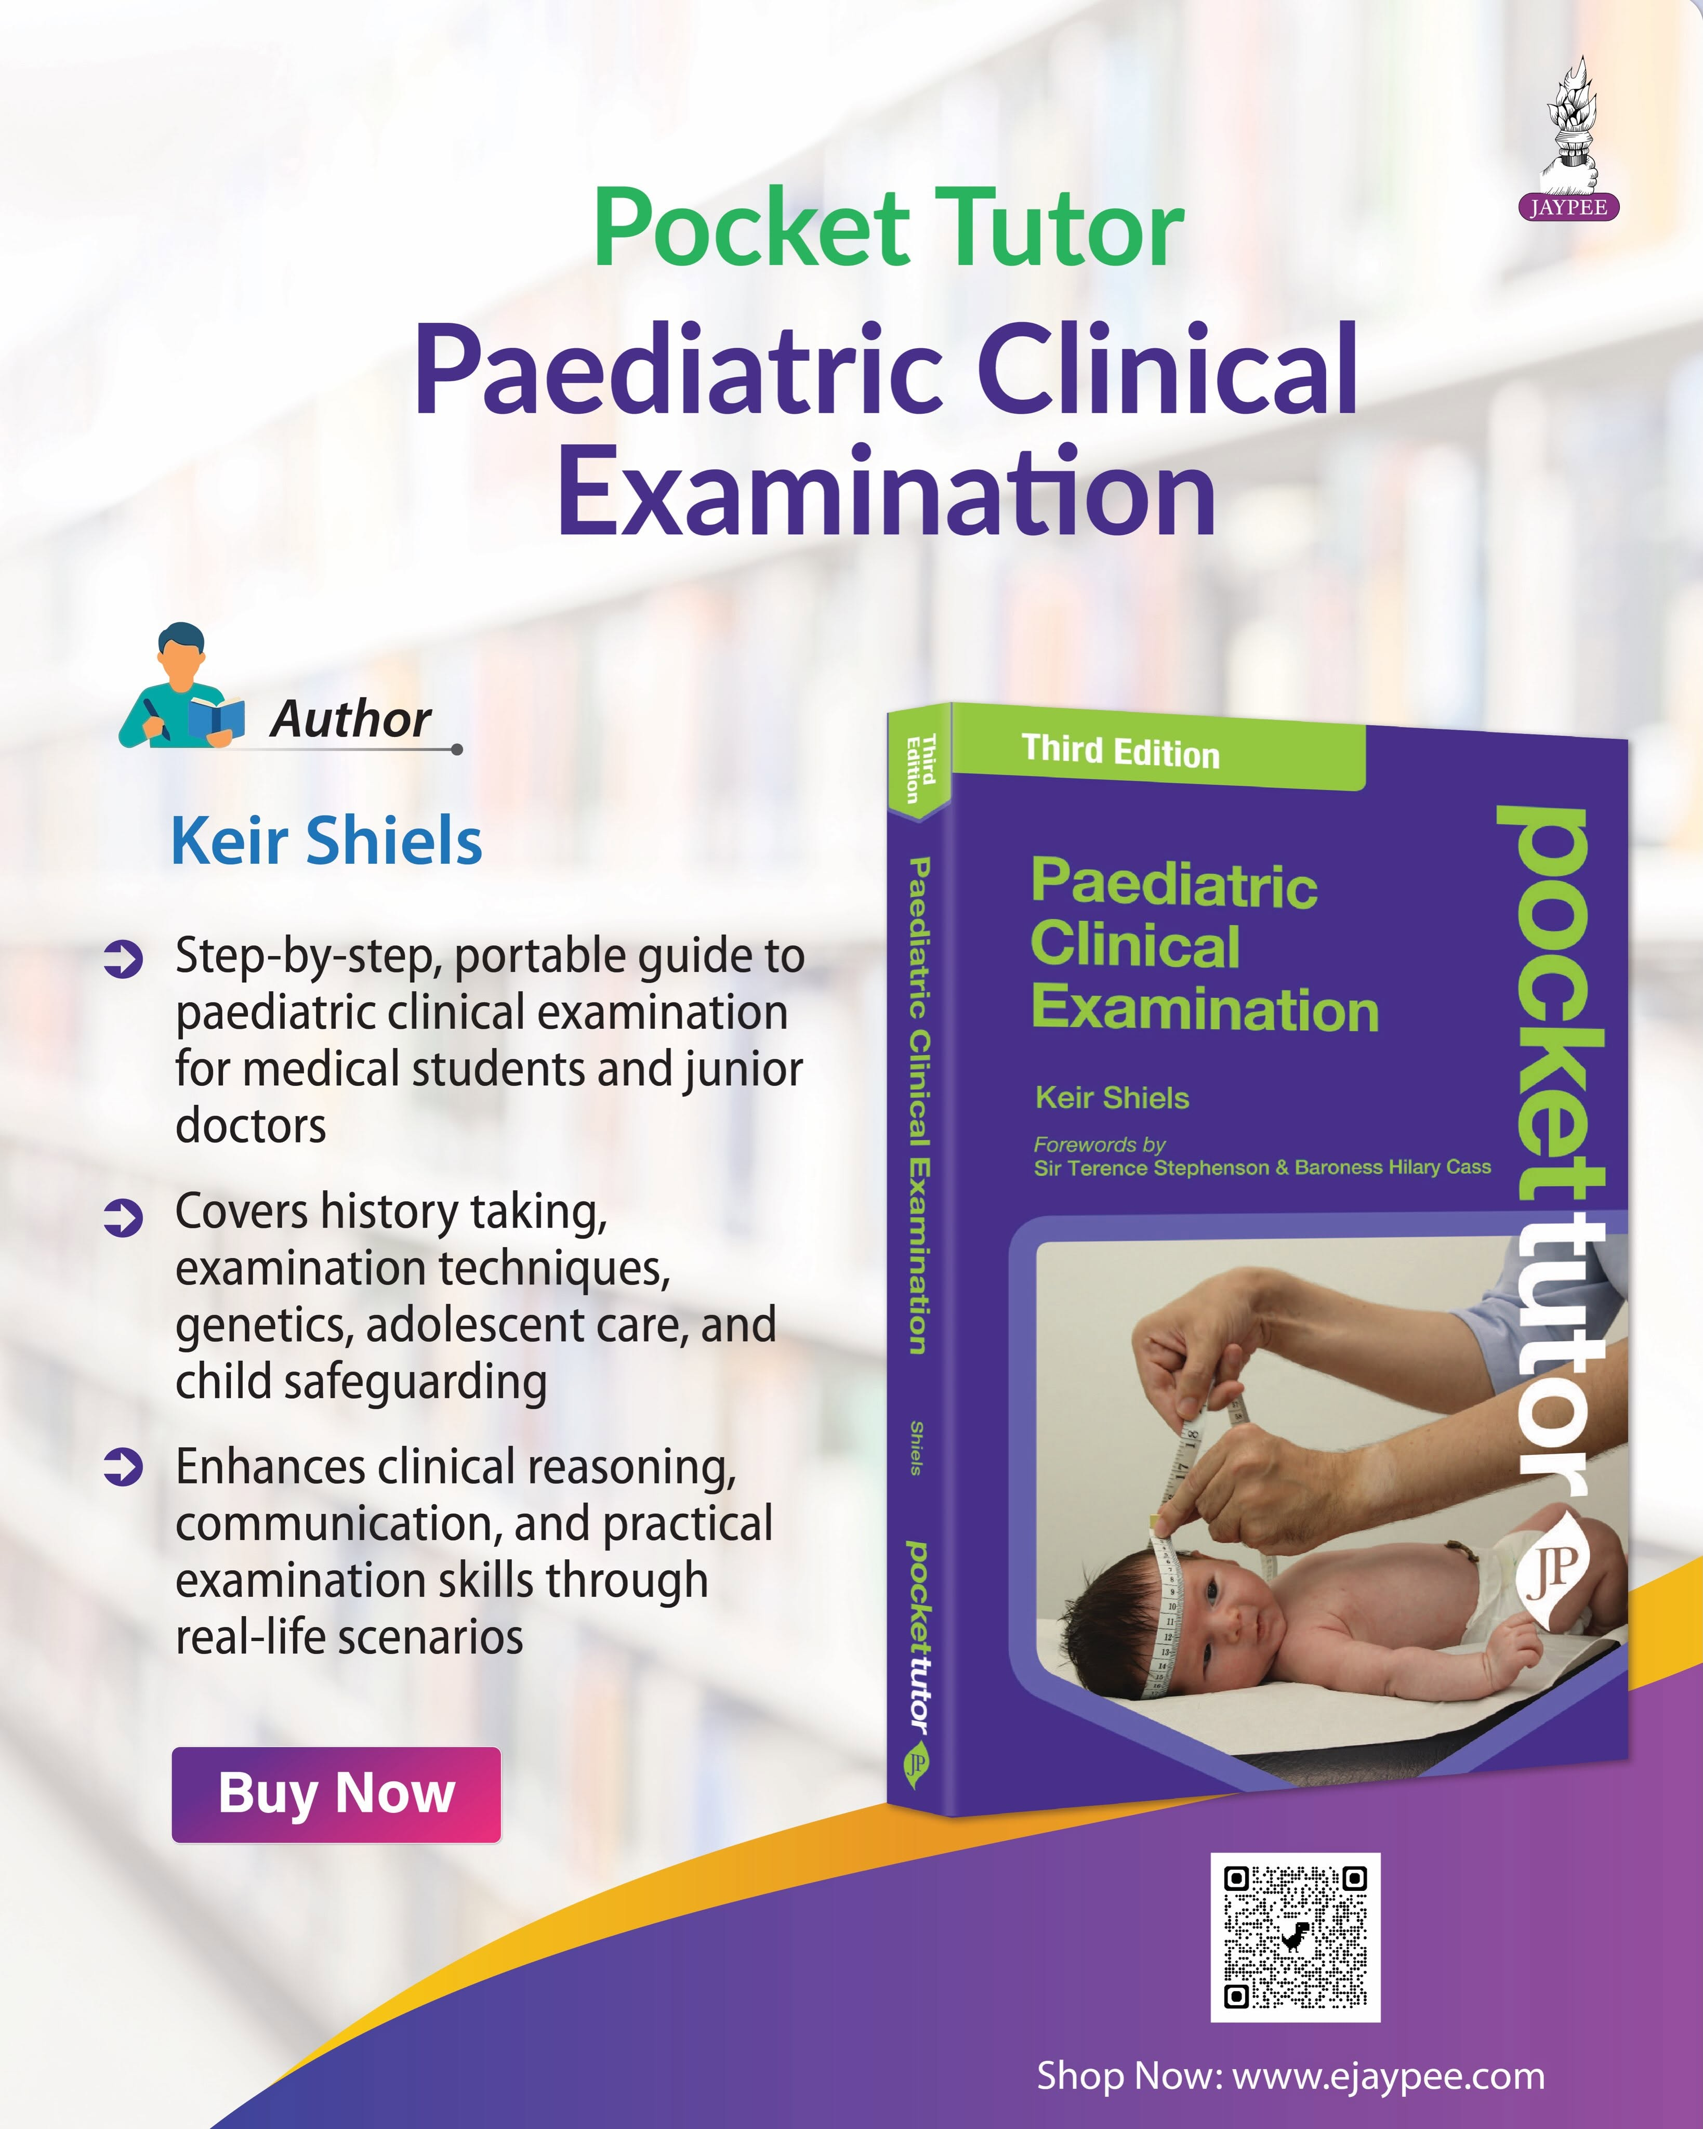
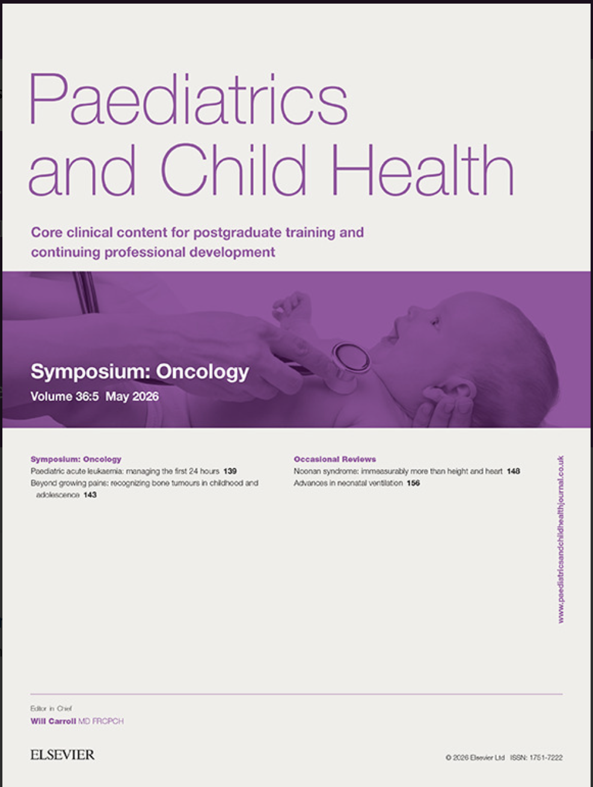
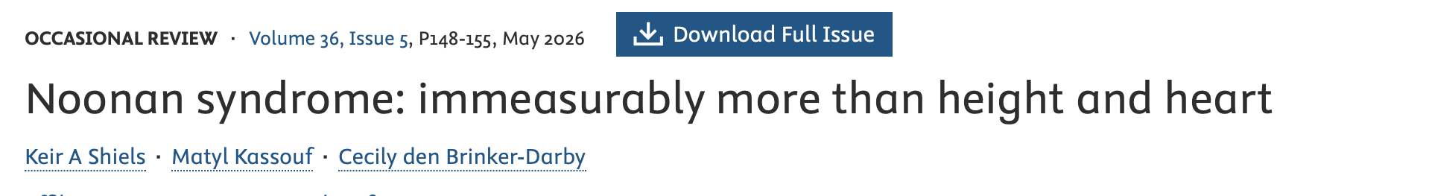
What am I doing?

Slide 42
What can you do?
https://www.surveymonkey.com/r/NoonanUSAUK

