Slide 1


Caregiver burnout:
Tangible & realistic steps towards improving family quality of life
Dr. Rachael L. Ellison
Noonan Syndrome Foundation Conference
7/30/2026

Slide 2
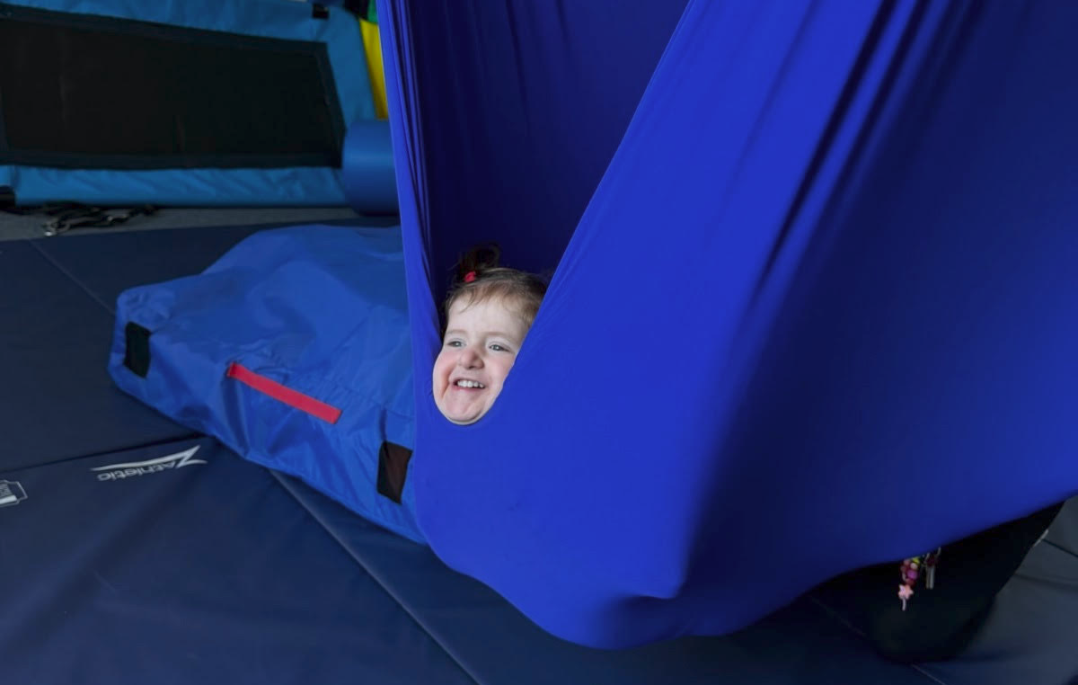

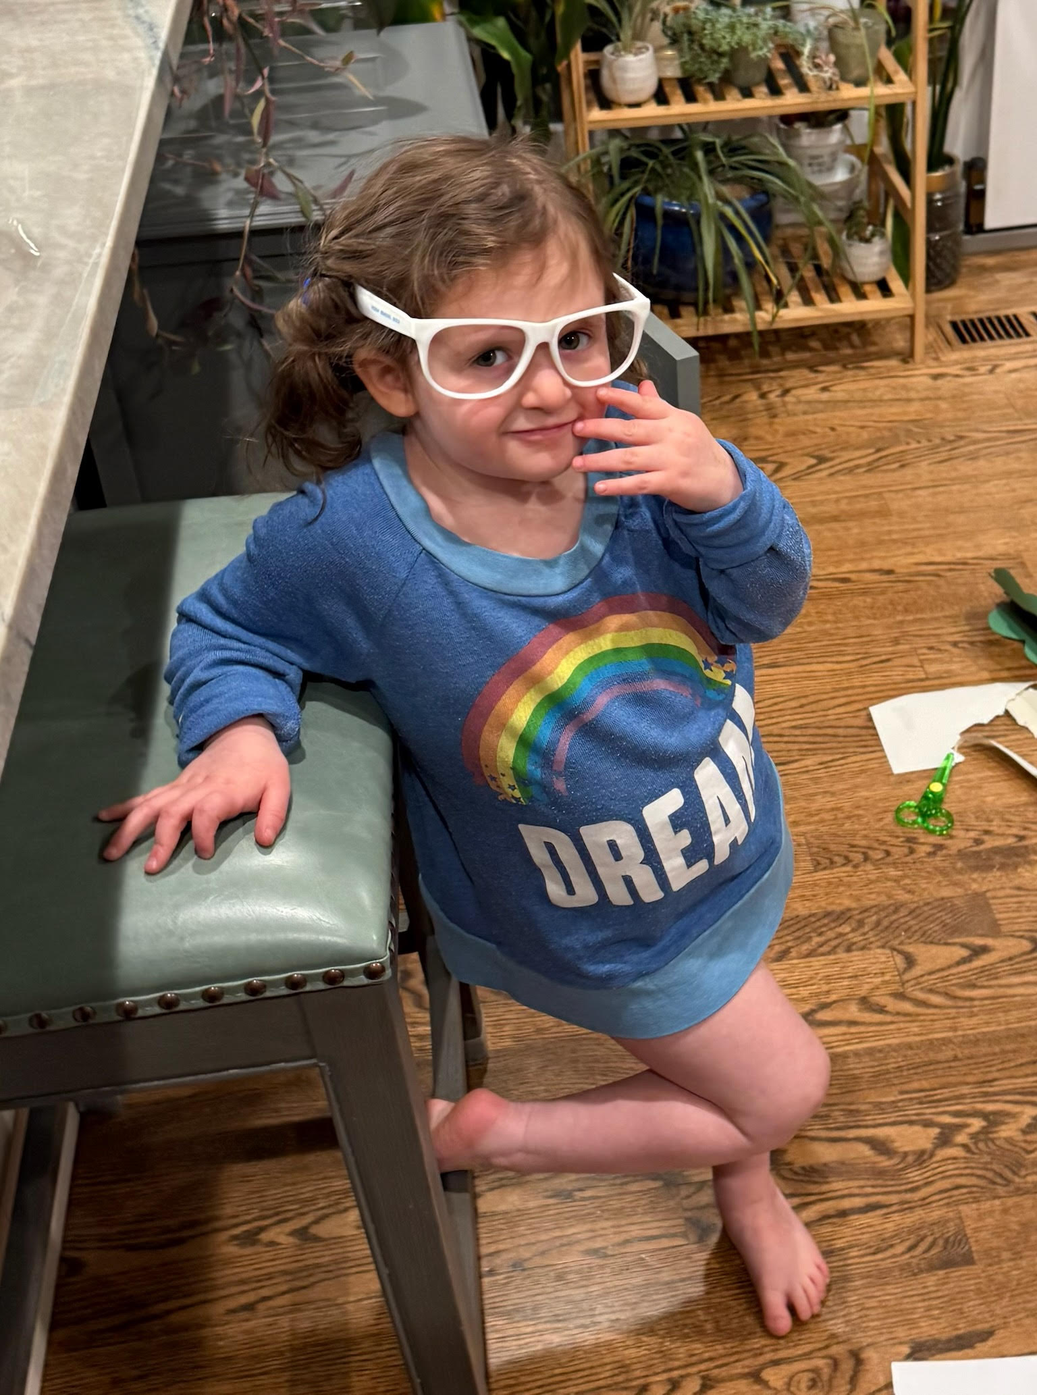
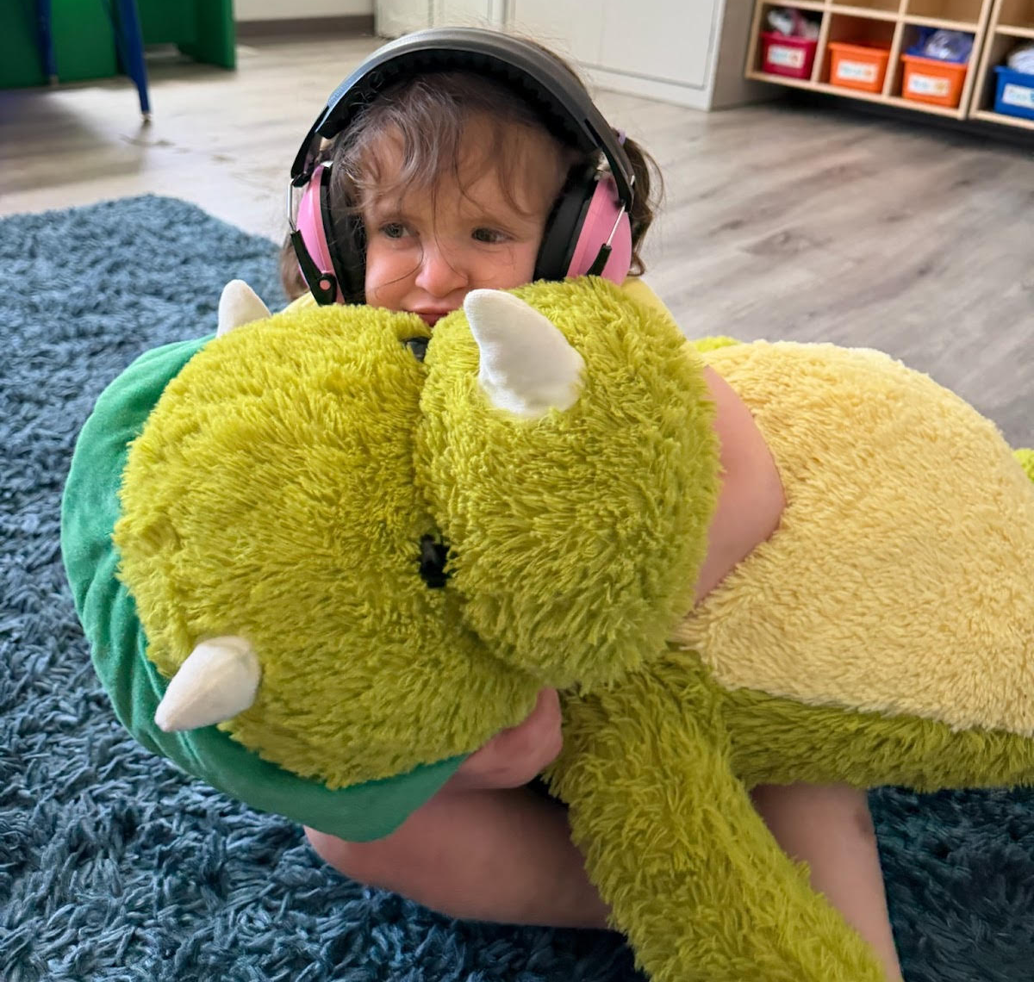

Introduction to Dr. Ellison

Slide 3
Session goals
Normalize burnout among parents caregiving for kiddos with extra needs
01
Review research on caregiver burnout
02
Discuss specific tips, tools, and strategies for minimizing burnout
03

Slide 4
Literature on caregiver burnout
Across studies, caregiver burnout is best understood as occurring across five interconnected domains:
  Emotional: chronic stress, grief, uncertainty, hypervigilance, anxiety
  Physical: fatigue, sleep loss, pain, impact on personal health
  Financial: lost wages, healthcare costs, insurance challenges, increased caregiver support costs, cost of specialized products/clothes, etc.
  Social: isolation, disrupted relationships, reduced leisure
  Systemic: fragmented care, bureaucracy, care coordination, difficulty accessing services

Slide 5
Literature on caregiver burden
Across studies, caregiver burden is best understood as occurring across five interconnected domains:
  Emotional: chronic stress, grief, uncertainty, hypervigilance, anxiety
  Physical: fatigue, sleep loss, pain, impact on personal health
  Financial: lost wages, healthcare costs, insurance challenges, increased caregiver support costs, cost of specialized products/clothes, etc.
  Social: isolation, disrupted relationships, reduced leisure
  Systemic: fragmented care, bureaucracy, care coordination, difficulty accessing services

Slide 6

Emotional aspects of caregiver burnout:
Noonan syndrome
Stress of unknowns (e.g., waiting for periods of elevated risk to pass)
Unknown of medical or academic/cognitive functioning for kiddo in the future
Exhausting having to stay on top of so many different medical specialties in addition to behavioral and/or academic concerns
Vigilance staying on top of safety concerns:
  Continuous concern about preventing medical crises, medication errors, equipment failures, or providers/sitters/other caregivers unfamiliar with kiddo’s condition
  Emotional toll of managing self-harm type behaviors during periods of emotional dysregulation
Image generated with GhatGPT

Slide 7
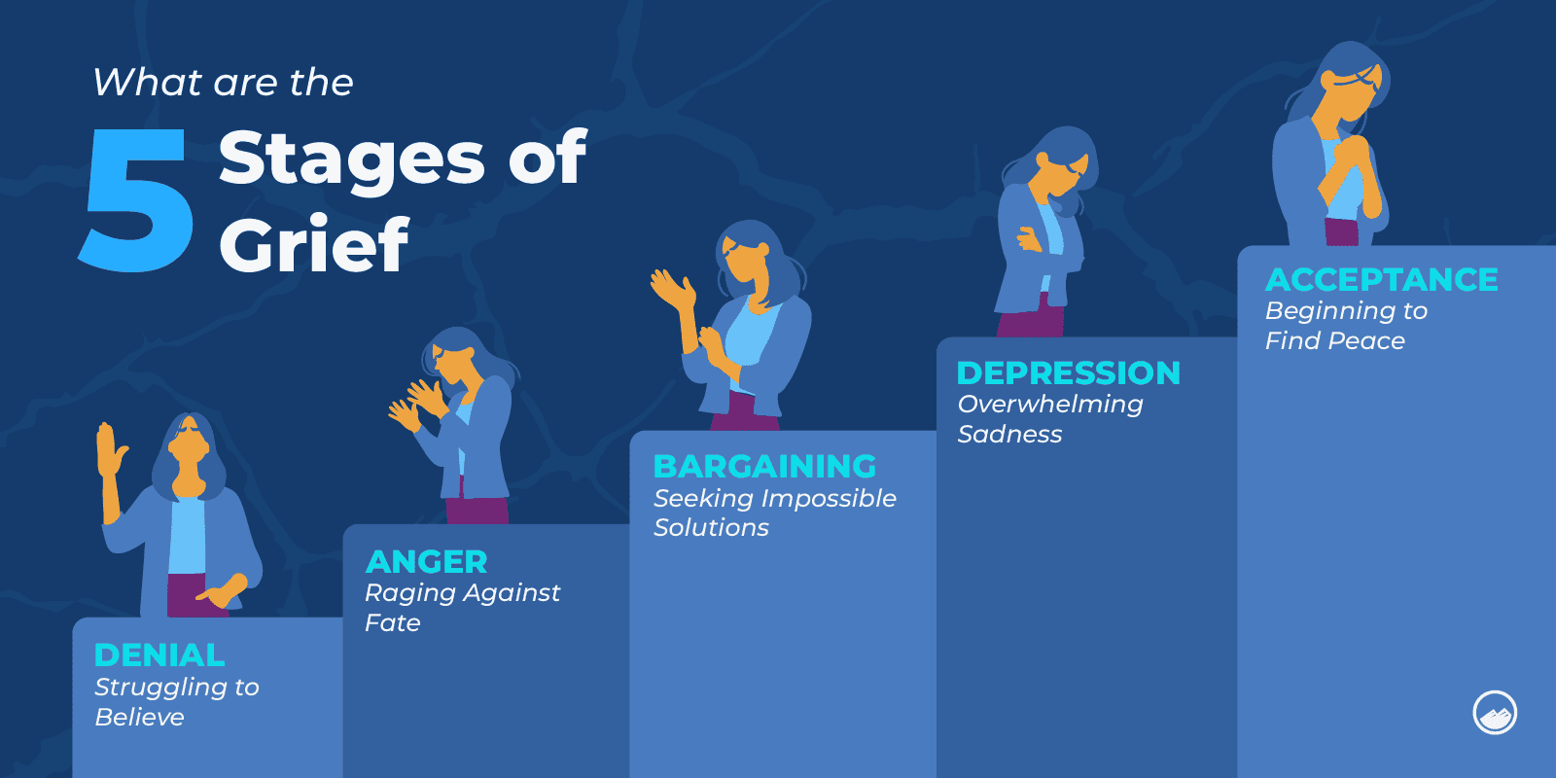
Emotional aspects of caregiver burnout, cont.
Possibly experiencing stages of grief at initial diagnosis of with subsequent medical diagnoses/changes – and navigating caregivers’ timing of different stages

Slide 8

Physical aspects of caregiver burnout
Accumulated dysregulated/disrupted sleep
  chronic sleep deprivation, which can worsens mood, cognition, and physical health
Fatigue associated both with disrupted sleep, as well as general stress
Potentially reduced time/opportunities for self-care (e.g., meal prep; slowing being able to sit and eat; consistent physical activity)
Image sourced from: https://www.akc.org/expert-advice/health/how-much-do-puppies-sleep/

Slide 9

Financial aspects of caregiver burnout
Additional costs for childcare (e.g., injection coverage + babysitter; caregivers/sitters with increased qualifications)
Impact of interventions/appointments/caregiving responsibilities on ability to work (at full capacity, or at all)
Cost of interventions not covered by insurance, or when maxing out benefits for the year
Financial cost of specialized products/clothes, etc. (e.g., $15 unfavored toothpaste; specialized interests; accommodating sensory needs, etc.)
Image generated with GhatGPT

Slide 10
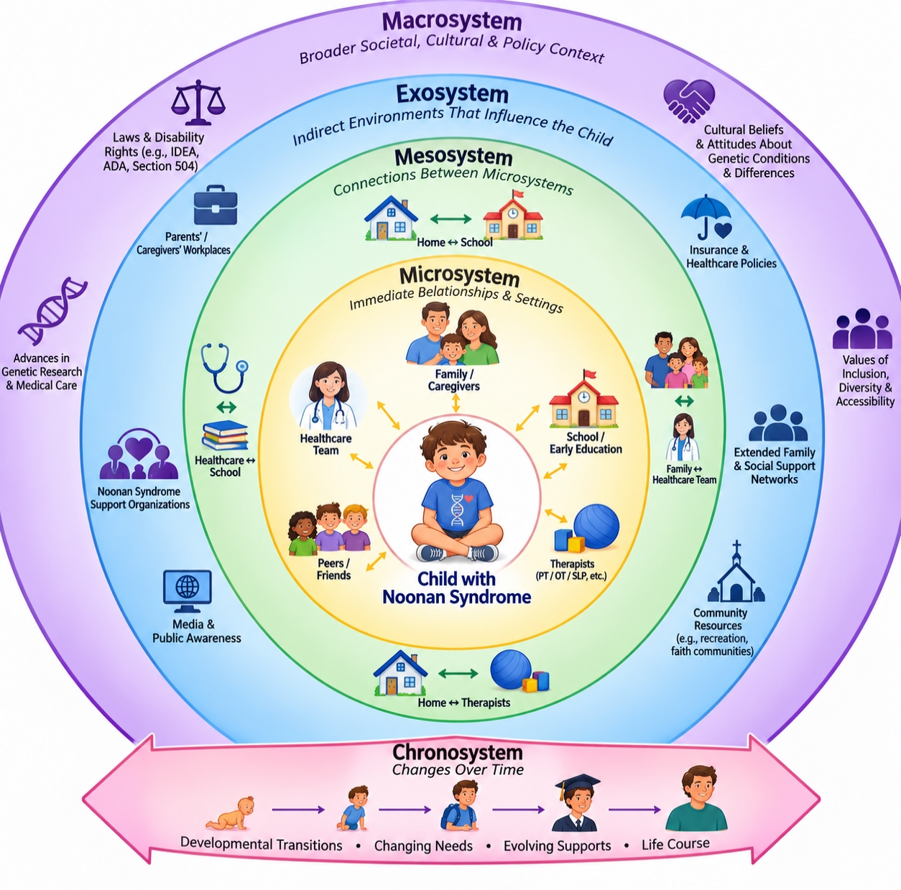
Social aspects of caregiver burnout
Impact to siblings
  Increased stress, increased feelings of responsibility, their own emotional reactions
  Reduced attention from parents/caregivers
Friends “that understand”
  Balancing optimism and positive outlook with not minimizing your experience
Caregiver reduced availability for social plans
  Coordinating around endocrine injection timing
  Childcare coverage
  Not wanting to stay out late because exhausted, or expectations of disrupted sleep
  Scheduling around kiddo appointments
Marital strain
Image generated with GhatGPT

Slide 11
Where we can intervene for reduced impact of caregiver burden
Across studies, caregiver burden is best understood as occurring across five interconnected domains:
  Emotional: chronic stress, grief, uncertainty, hypervigilance, anxiety
  Physical: fatigue, sleep loss, pain, impact on personal health
  Financial: lost wages, healthcare costs, insurance challenges, increased caregiver support costs, cost of specialized products/clothes, etc.
  Social: isolation, disrupted relationships, reduced leisure
  Systemic: fragmented care, bureaucracy, care coordination, difficulty accessing services

Slide 12

Reducing social isolation and increasing social support
Intentionality in calendar planning (e.g., trying to organize a monthly dinner, or bi-monthly calendar reminders to organize XYZ).
Sometimes partner may be in different place/space in processing everything is going on- reflect if you need additional supports?
Consider using Noonan Syndrome groups to facilitate/organize meet-ups
Using tools like FB groups (e.g., even neighborhood parent groups) to see if you can organize a quarterly dinner for parents with kiddos with extra needs
Kiddos’ pediatric or hospital system may have opportunities for parent groups, or formal therapeutic parent support groups
Coming to conferences like this!
Image obtained from: https://www.verywellmind.com/social-support-for-psychological-health-4119970

Slide 13
Working with your internal self-talk: dialectics and self-compassion
Working with a kiddo with extra needs, especially if there are behavioral/ sensory/ neuropsychiatric needs, can be exhausting- and you are not a robot!
  Sometimes we are not fully present.
  Sometimes we may not give 100%.
  Sometimes we may lose our temper, or not be our best self.
Practicing dialectic thoughts- holding space for two contradictory/opposing thoughts
“I’m doing the best that I can in this moment
AND
maybe I could have handled that better”

Slide 14
Calendar planning for routine, scheduled time away
Working with partner/family in weekly or monthly calendar planning to schedule in protected time for you (bonus points if you can care out some activities you enjoy or that recharge you)
Avoid the ‘all or nothing’ trap
  E.g.: Can you get a walk around the block by yourself?
  20 minutes away vs. an afternoon or full day?
  Can someone else help do bedtime and you just get ready for bed early and start an audiobook or show but you’re still at home? (my favorite)
Intentionally planning and scheduling (or pre-discussing intentionally) can also help to reduce the guilt of not helping the other parent/caregiver

Slide 15
Communication around task burden with joint caregiver
Self reflection, and then communication with joint caregiver:
  Are there certain tasks that drain you more or stress you out more?
  Certain times of day where caregiving is more burdensome for you?
Can you reallocate tasks (even if not all the time, part of the time) to reduce tasks that are more emotionally draining?
  E.g., If we’re both home, husband does bedtime with my kiddo with Noonan Syndrome most nights, I do at least 2 nights per week
  E.g., I handle early morning with both kiddos, but husband almost exclusively does brushing of teeth (I don’t know why but I absolutely hate doing this)
Having choice and autonomy of tasks can help, at times, to reduce the emotional burden of overall task/responsibility load

Slide 16
Improving Communication between caregivers
Chosen word between adults for being able to communicating discretely that need to “tap out and need support to step in”
Explicit communication of needs in stressful conversations
  Do you want to just vent? Do you want advice? Do you want validation?
  Do you NOT want your concerns to be minimized?
Self-reflection- do you know which fits for you? Which fits for your partner?
  Are you someone who needs the repetition of content in a discussion for closure?
  Frustration when mismatch between communication needs (e.g., someone for who it’s cathartic to re-communicate or discuss vs. someone who that is frustrating to hear it again)

Slide 17
Recognizing unseen effort
For some, there may be the experience of an unseen lift or invisible labor, especially if it ends up not being equitably distributed among caregivers
  E.g., one person managing more of the medical appointment, or more of the communication with providers
  Or one person who is stepping in more to assist with childcare, or whose work day is more interrupted
It may not be realistic or practical to make the mental and time burden equitable- but what are ways that the person doing this aspect of heavy lifting can be ‘seen’?
  If you are that person with unseen effort/labor- self-reflection on your own needs and communicate with your partner
    Do you want time/space to be able to vent or go through in your day all those little things that you did or managed?
    Do you want verbal validation (e.g., thank you for… XYZ)?

Slide 18


Summary & take home message
It is normal to experience periods of increased caregiver burnout
Caregiver burnout is serious and can have significant impact on yourself and your family system
There are steps that you can take individually as well as within your family system to help reduce the impact of caregiver burnout
Being connected with larger communities such as this and coming to events like the Family Conference can help to reduce overall caregiver burnout – we’re glad you’re here!

Slide 19
Thank yoU!
Any questions?
Feel free to approach me during the rest of the conference, or email me at rachael.ellison@rosalindfranklin.edu

