Slide 1

Feeding
Difficulties
Dr Keir Shiels
MA MB BChir FRCPCH FAcadMEd
Great Ormond Street Children’s Hospital, London

Slide 2


The RASopathy Specialist MDT
General Pediatrician
Complex Care CNS
Initial Consultation
Cardiology
Pediatrician
Neurodevelopment
Endocrine
Orthopedics
Genetics
Follow up every 3 years

Slide 3




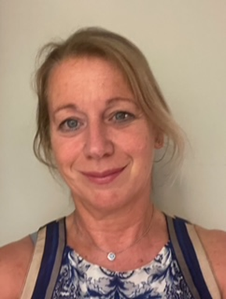



Ang Roberts (Gen)
Juan Kaski (Cardio)
Anish Sanghrajka (Ortho)
Lee Hudson (Res)
Elaine Clark (Dev’t)
Mehul Dattani (Endo)
Harshini Katugampola (Endo)
Keir Shiels (Lead)

Slide 4
Rasopathy Management
Medical Background
Growth and Puberty
Cardiac Status
Genetic Assessment
Vision and Hearing
Hair and Teeth
Skin
Musculoskeletal Development
Bleeding Risk
Social and Educational Development
Feeding and Nutrition

Slide 5
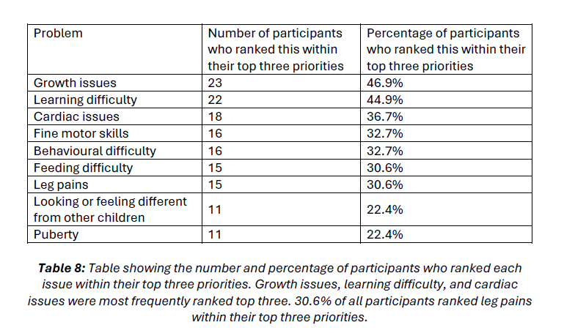

Slide 6
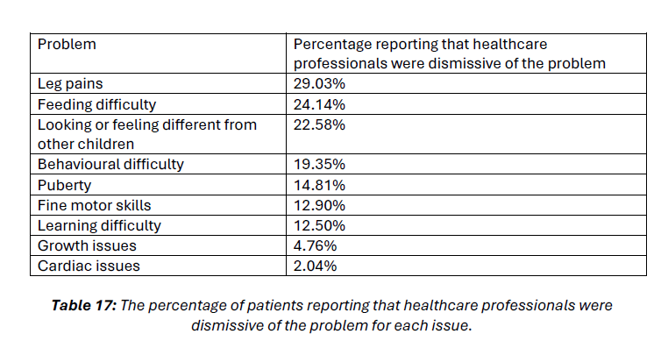

Slide 7
Birth – Cardiac, Chylothorax
0-2 years - Vomiting
1-4 years – Oral aversion
4 years on – Textural, Visual & smell sensitivities
Dysregulated Appetite

Slide 8
Birth – Cardiac, Chylothorax
0-2 years - Vomiting
1-4 years – Oral aversion
4 years on – Textural, Visual & smell sensitivities
Diagnostic overlay & Diagnostic overshadowing
Misdiagnosis and mismanagement
(Reflux, milk allergy…)
Feeding Adjuncts (NG, NJ, PEG)
Autism Spectrum
ARFID
Fussy Eating
Dysregulated Appetite

Slide 9
Feeding Problems
Low appetite ‘Grazing’
Low stomach capacity ‘Full quickly’
Slow gut transit
Quick vomiting
Step back with illnesses

Slide 10
In Early Years prioritize tolerance
Swapping formulas is unlikely to help much
Work to appetite
Work to stomach capacity
Use tubes for calories
Maintain oral intake as extras

Slide 11

Repeating unpleasant things creates fear

Slide 12

Cyproheptadine: Appetite stimulant

Slide 13
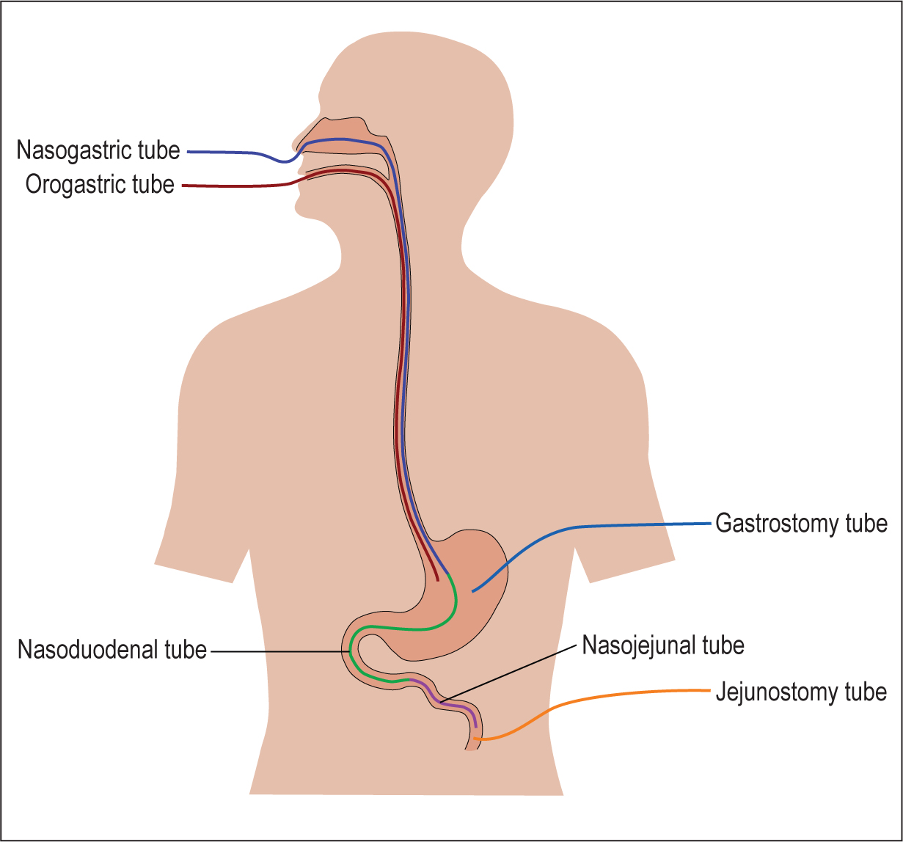
Types of tube

Slide 14

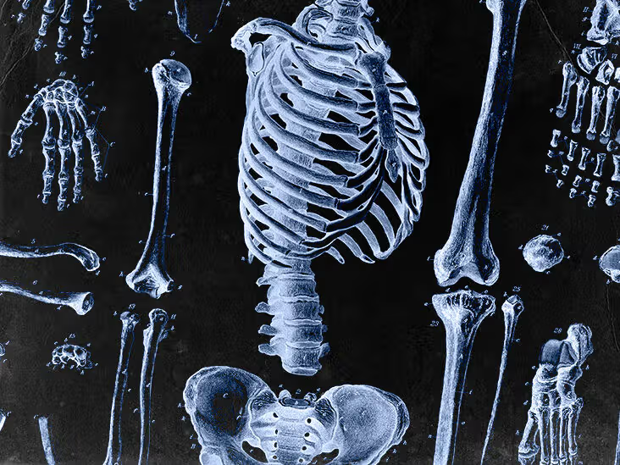

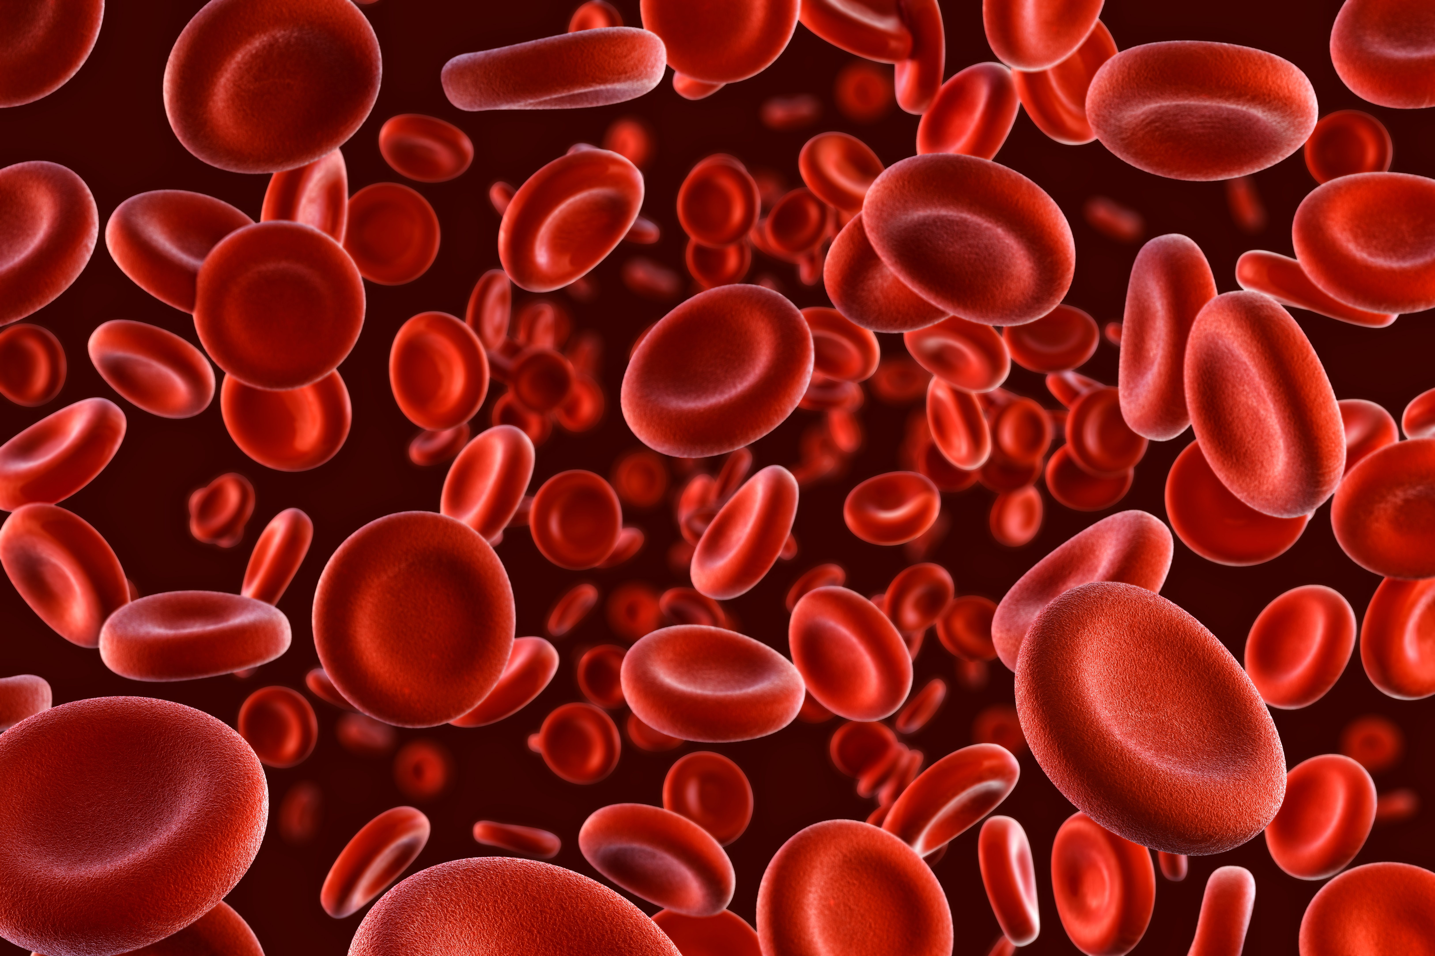
Effects of feeding difficulties

Slide 15


Slide 16
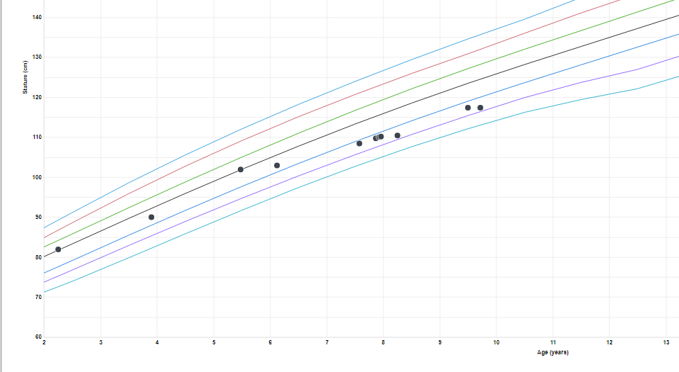
Confounding factors

Slide 17
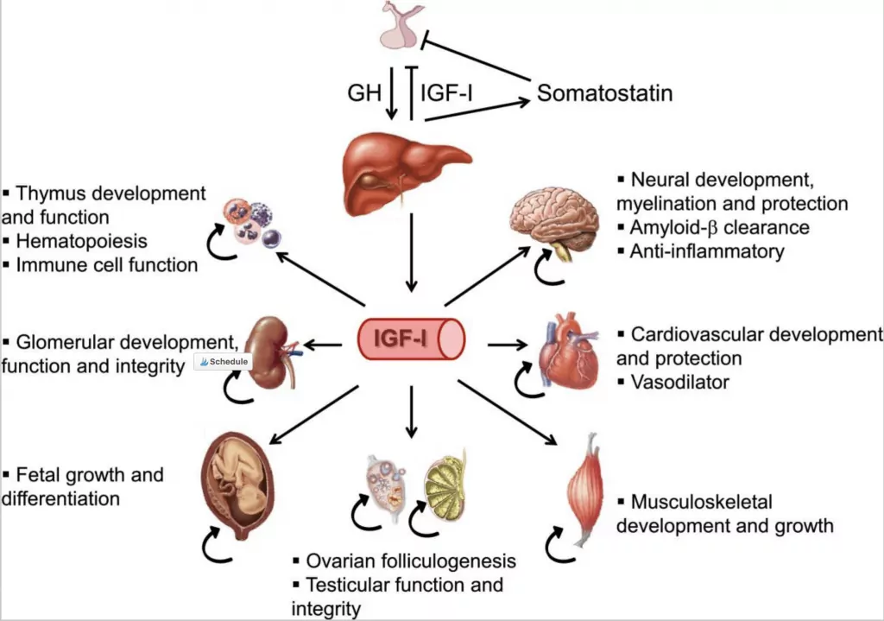

Slide 18
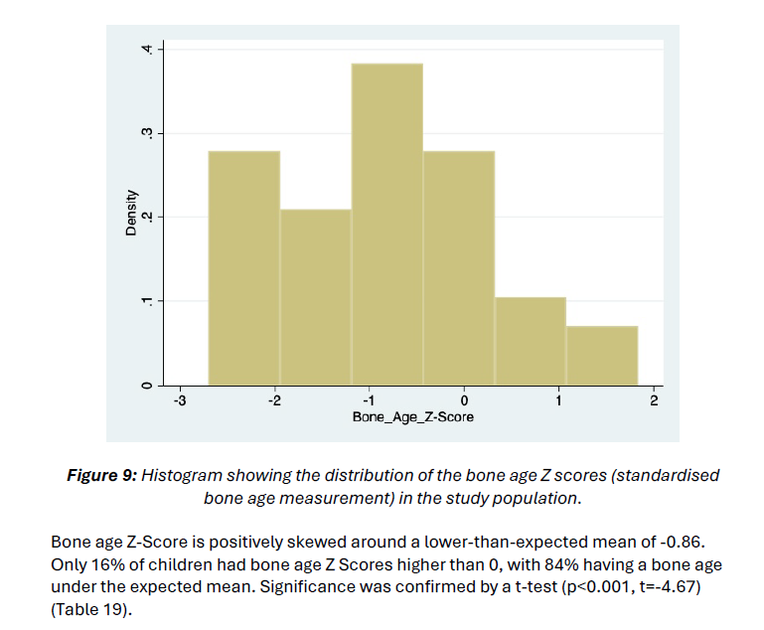

Slide 19
Parents are concerned about fussy eating

Slide 20
Parents are concerned about fussy eating

Slide 21
Why won’t my child try new things?
How can I show my child that foods are tasty?

Slide 22


Spencer’s Lemon

Slide 23


Slide 24


Slide 25
Expectation Alters Perception

Slide 26
Exposure to a pleasant surprise is not aversion therapy
Afraid of dogs
Walk past a good dog unharmed
Still afraid of dogs

Slide 27
Exposure to a pleasant surprise is not aversion therapy
Afraid of trying beef
Taste beef and find it’s ok
Still afraid of trying beef

Slide 28
Perception does not easily alter expectation

Slide 29
Coercion is Counterproductive

Slide 30

Why are you worried? Really?

Slide 31
Agitation
Alters Perception

Slide 32
Parents are concerned about fussy eating

Slide 33
Parents are concerned about fussy eating

Slide 34
At Great Ormond Street
We treat the Child
We treat the Child’s Family
We treat the Child’s Healthcare Professionals

Slide 35
Professionals Referral Clinic
Psychologist
Psychiatrist
Paediatrician
Local Dietician
Local Paediatrician
Local OT

Slide 36
Feeding and Eating Disorder Service
ARFID and Autism Spectrum Behaviours
Nutritional Management
Family Pressures
Expectation Management
Reducing the child's stress around food
Integrating plans with family, school and local services

Slide 37
Outcomes
Autism Assessments
Family Therapy
Feeding and Eating Disorders Service
Advice and plan
Reassurance

Slide 38
Issues
Feeding is poorly understood by professionals
Appetite, behavior, preferences, fears and nutrition are different issues requiring different strategies
Typical markers of poor nutrition can be red herrings in RASopathies
Coercion is counterproductive (Agitation alters perception)
Expectation takes time to change (Peer pressure is better than parental pressure)
Best prognosis is when the child themselves wants to change behavior.
Fussiness is a problem for the family, even when it does not result in nutritional insufficiency
Reassurance is a process that may require significant change. It is hard.

Slide 39

Help us!

